Slide 1

The Bible

Slide 2
What is the Bible and
can we trust it?

Slide 3
The Bible is not just a book.
It’s a library of 66 books.
  Written over a span of 1500 years
  Written by over 40 different authors (fishermen to kings)
  Written in 3 different languages (Hebrew, Aramaic, Greek)
  Written on 3 different continents (Asia, Africa, Europe)
Yet, when approached as a whole…
the Bible has one clear message!

Slide 4
The Bible is God’s message to us

Slide 5
The Bible is not a book of rules,
it’s a book of love and hope

Slide 6
Psalm 19:7-11
The instructions of the Lord are perfect, reviving the soul.
The decrees of the Lord are trustworthy, making wise the simple.
The commandments of the Lord are right, bringing joy to the heart.
The commands of the Lord are clear, giving insight for living.
Reverence for the Lord is pure, lasting forever.
The laws of the Lord are true; each one is fair.
They are more desirable than gold, even the finest gold.
They are sweeter than honey, even honey dripping from the comb.
They are a warning to your servant, a great reward for those who obey them.

Slide 7
Romans 15:4
Such things were written in the Scriptures long ago to teach us. And the Scriptures give us hope and encouragement as we wait patiently for God’s promises to be fulfilled.

Slide 8
The Bible contains many true, wonderful stories… yet there is
one main character,
one main theme,
and
one main message.

Slide 9
  The main character is Jesus Christ
  The main theme is redemption / restoration
The main message is…
Jesus Christ restores a world that has
been broken and devastated by sin

Slide 10
How did we get our Bible?

Slide 11
The Bible was delivered to us
from God through men

Slide 12
God’s Word originated from God (Revelation & Inspiration)

Slide 13
Inspired = God breathed
Revealed = uncovered

Slide 14
I Corinthians 2:13
When we tell you these things, we do not use words that come from human wisdom. Instead, we speak words given to us by the Spirit, using the Spirit’s words to explain spiritual truths.
II Timothy 3:16-17
All Scripture is given by inspiration of God, and is profitable for doctrine, for reproof, for correction, for instruction in righteousness, that the man of God may be complete, thoroughly equipped for every good work.

Slide 15
II Peter 1:19-21
Because of that experience, we have even greater confidence in the message proclaimed by the prophets. You must pay close attention to what they wrote, for their words are like a lamp shining in a dark place—until the Day dawns, and Christ the Morning Star shines in your hearts. Above all, you must realize that no prophecy in Scripture ever came from the prophet’s own understanding, or from human initiative. No, those prophets were moved by the Holy Spirit, and they spoke from God.

Slide 16
II Peter 3:15-16
And remember, our Lord’s patience gives people time to be saved. This is what our beloved brother Paul also wrote to you with the wisdom God gave him—speaking of these things in all of his letters. Some of his comments are hard to understand, and those who are ignorant and unstable have twisted his letters to mean something quite different, just as they do with other parts of Scripture. And this will result in their destruction.

Slide 17
God communicated His mind and heart through man, in order to bless us now, and into eternity

Slide 18
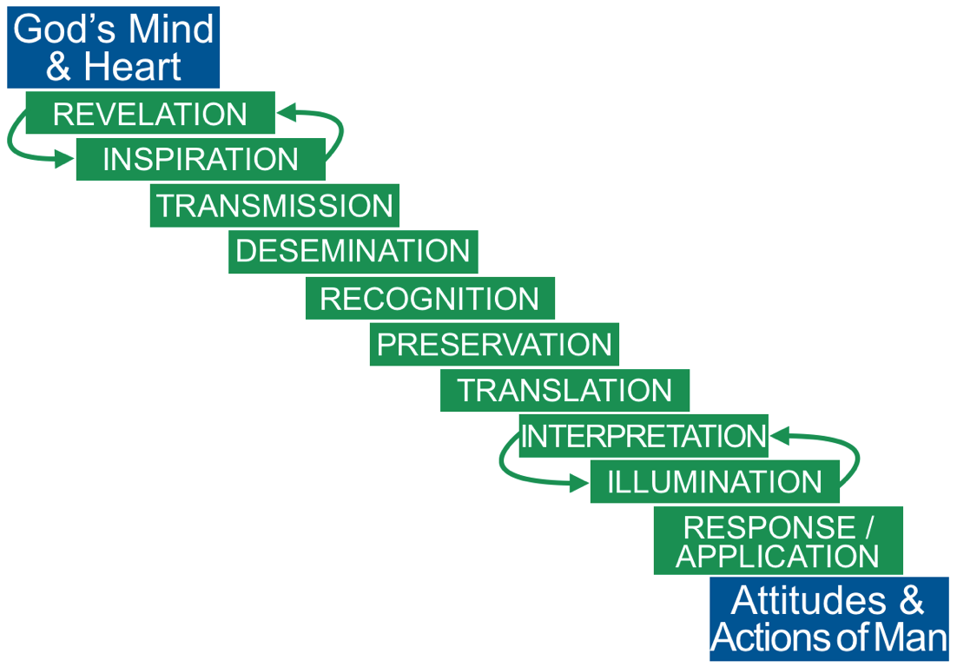

Slide 19
There are many spiritual writings, so how do we know which books to include in our Bible?

Slide 20
The list of books that have been universally accepted to be inspired by God and authoritative for faith and life are called the Canon

Slide 21
The Canon
lit. - Greek: rule/measuring stick
The list of books that have been universally accepted to be inspired by God and authoritative for faith and life
  Universally accepted by 397 AD

Slide 22
Criteria to be part of the Canon
  Written by a recognized prophet, apostle, or or one in close proximity to them
  Truthful
  Confirmed by Christ, prophet, or an apostle
  Faithful / Aligned with previously accepted canonical writings
  Church usage and recognition

Slide 23
God determined the Canon,
the Church discovered the Canon

Slide 24
How do we know we can trust the Bible?

Slide 25
  Fulfilled Prophecy
  Textual Accuracy
  Archeology
  Attacked but not crushed
  Complete life transformations it’s made for thousands of years

Slide 26
What is the Bible and can we trust it?

Slide 27
The Bible is a library of 66 books that contain God’s written message to mankind, a trustworthy guide for daily living and eternal life.

Slide 28
II Timothy 3:16-17
All Scripture is given by inspiration of God, and is profitable for doctrine, for reproof, for correction, for instruction in righteousness, that the man of God may be complete, thoroughly equipped for every good work.

Slide 29
The Bible

