Slide 1
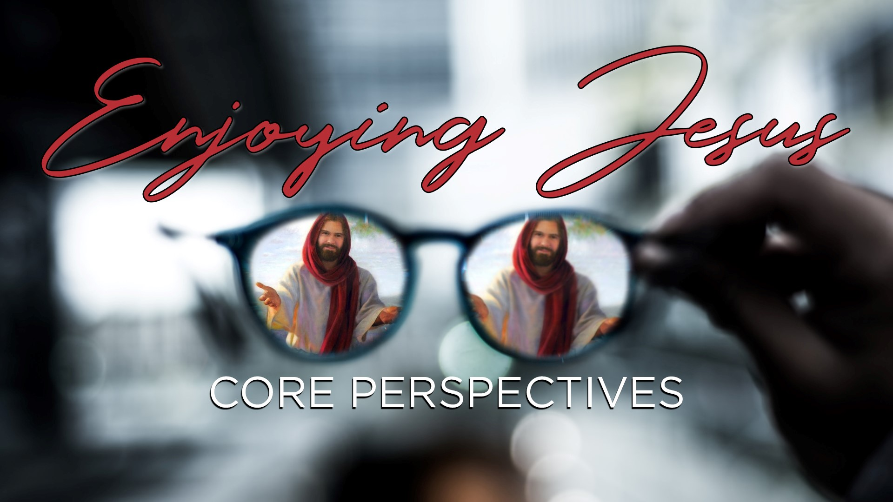

Slide 2
Purpose of Vision
Define our Identity
  Who God is calling us to be
Define our Methodology
  How God is calling us to be
Define our Direction
  Where God is calling us to be

Slide 3
Value of Vision
Common Language
  Better Communication
Common Perspective
  Better Community
Common Goal
  Better Effectiveness

Slide 4
Typical Perspectives
Growing Closer to God
  Behavior Modification
  Behavior = Closeness = Success
Problem
  Encourages Legalism
  Creates Hierarchy

Slide 5
Typical Perspectives
Growing Impact & Influence
  Engagement in Program
  Influence = Faithful = Success
Problem
  Encourages Triumphalism
  Creates Homogeny

Slide 6
Power of the Spirit
Matt. 4:19; 28:18-20
Acts 1:5-8;
Romans 8
Gal. 2:20; 5:22-25
Phil. 1:6; 2:12-13

Slide 7
Shifting the Paradigm
We Are Successful
  Relationship is our Goal
    What we are created for
  Perfect Relationship
    Not striving for God
  All of the Spirit
    Not striving for Spirit

Slide 8
Shifting the Paradigm
Great Motivator
  Living by the Law
    Gal. 3:3 – Having begun by the Spirit
    Some don’t know love
  True Transformation
    God’s love motivates us to love
    Not fear of judgment
    Not self-discipline

Slide 9
Shifting the Paradigm
Jesus Leads
  We Follow Jesus
    Not people or church
    He tells us where to focus
  Church Follows Jesus
    Not pastor or elders
    He tells us corporately

Slide 10
Shifting the Paradigm
Our Sanctification Equation
  Success =
  Enjoyment of God =
  Behavior & Influence

Slide 11
Trinity Alliance Vision
We Are…
Fully enjoying our relationship with Jesus Christ.
Through…
Relying on the power of the Holy Spirit, God’s Word and prayer.
Journeying in life with our church family in honesty and humility.
Engaging our neighbor with God’s love in authentic and caring relationship.

Slide 12
Fully Enjoying
Focus on Relationship
  We are all called
  What draws us together
  What launches us into ministry

Slide 13
Fully Enjoying
Focus on Enjoying
  Not trying to get closer to God
    More fully aware of his presence
  Not trying to earn his favor
    More fully aware of his blessings
  Not trying to do his work
    More fully join him in his work

Slide 14
Enjoyment Context
Relationship with our God
  Relying on H.S., God’s Word, Prayer
Relationship with our Church
  Journeying in Honesty & Humility
Relationship with our Neighbor
  Engaging in Authentic & Caring

