Slide 1
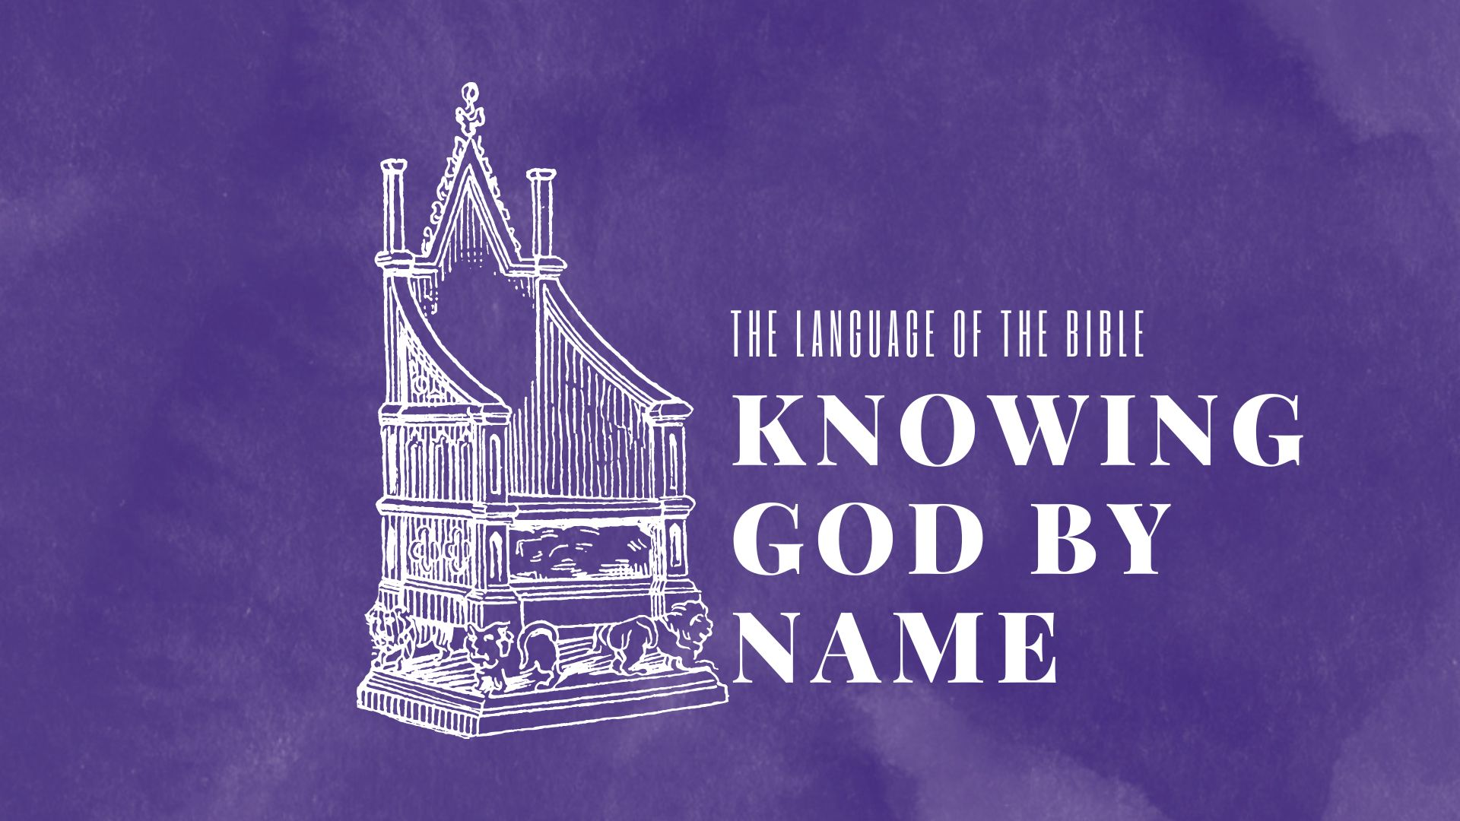

Slide 2

Hebrews 12:2
“looking to Jesus, the founder and perfecter of our faith, who for the joy that was set before Him endured the cross, despising the shame, and is seated at the right hand of the throne of God.”
(more of a title than a name)

Slide 3
“the founder” (or author)
Archégos: a person who is originator and continues as leader
  only used as Christological title; from 2 Greek words meaning “beginning” and “brought”
Acts 3:14-15 & 5:30-31
Hebrews 2:10
1 Timothy 1:9

Slide 4
“and perfecter”
Only appears this one time in NT
  teleiótés: Perfection, completeness, maturity
  From teleioo; a completer, i.e. Consummator
Ephesians 4:13 (see also Col 1:28)
Philippians 1:6
Hebrews 6:9, 19-20
Hebrews 7:19, 28

Slide 5
“of our faith”
Faith is distinct from belief but involves it and vice versa (you can have accurate beliefs but not faith) (Hebrews 11:6)
John 12:42-43
  Consider Romans 10:9-10 “confess and believe”
Acts 8:13, 18-21
Acts 26:27-28
James 2:18-19

Slide 6
“of our faith”
Faith is the work God does, the gift of God…
  Romans 3:27
  Romans 12:3
…that births trust & persuasion lived out in assurance (i.e., evidenced in our behavior).
  2 Thessalonians 1:11
  Matthew 8:5-13
  Matthew 9:20-22

Slide 7
“the founder & perfecter of our faith”
Put it all together
1 Thessalonians 5:23-24
Hebrews 10:19-25, 35-39
Did you hear Jesus as the originator? Did you hear the promise of completion in Jesus? Did you hear the call to live out in action?

Slide 8
This Week Let’s All
Read: Daniel 12. Hosea 13 & 14. John 6. Revelation 7
Pray: As led by the Holy Spirit and the reading
Remember: Psalm 7:10
Reflect: Does your life demonstrate you have just belief or faith?
Apply: Praise God for beginning and leading your faith, and His promise of the completion of it!

