Slide 1


Slide 2
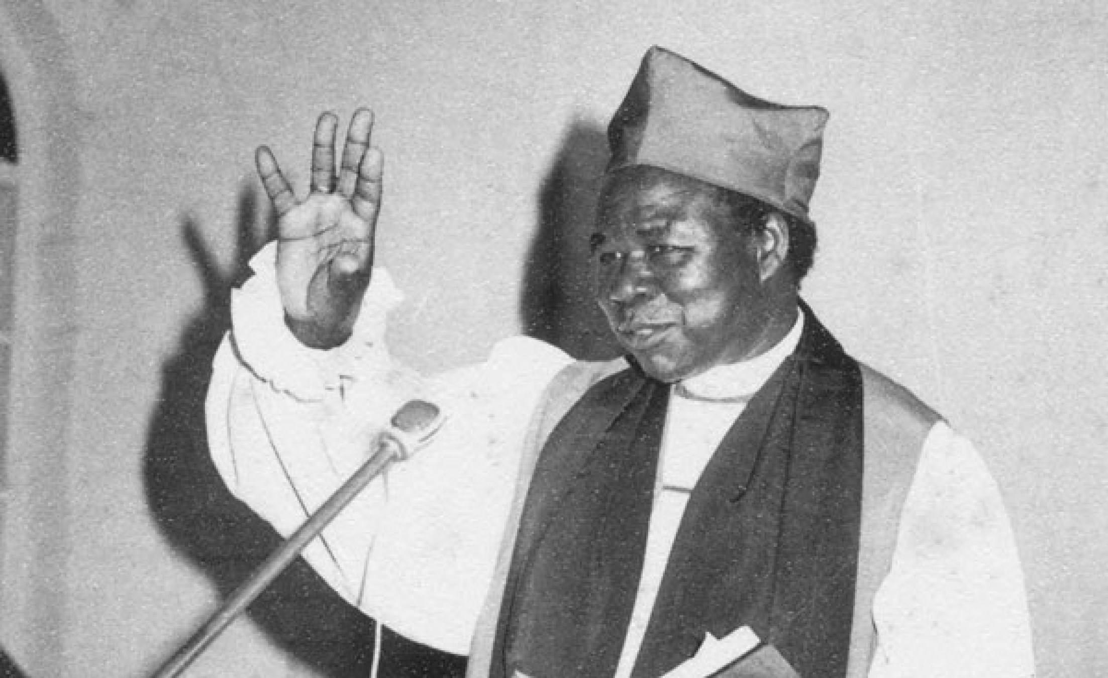

Slide 3
“While the opportunity is there, I preach the gospel with all my might, and my conscience is clear before God that I have not sided with the present government, which is utterly self-seeking.”
- Janani Luwum

Slide 5
John, the author (Rev 1:1-2, 9)
The seven churches (Rev 2-3)
The martyrs (Rev 6:9-11)
The 144,000 (Rev 7:1-8; 14:1-5)
The great multitude from every nation (Rev 7:9-17)
The prayerful saints (Rev 8:1-5)
The two witnesses (Rev 11:1-13)
The woman and her offspring (Rev 12)
The reigning martyr-kings (Rev 20:4-6)

Slide 7
^{2:1} To the angel of the church in Ephesus write: ‘The words of him who holds the seven stars in his right hand, who walks among the seven golden lampstands.
² I know your works, your toil and your patient endurance, and how you cannot bear with those who are evil, but have tested those who call themselves apostles and are not, and found them
- Revelation 2-3, ESVUK

Slide 8
to be false. ³ I know you are enduring patiently and bearing up for my name's sake, and you have not grown weary. ⁴ But I have this against you, that you have abandoned the love you had at first. ⁵ Remember therefore from where you have fallen; repent, and do the works you did at first. If not, I will come to you and remove your lampstand from its place, unless you repent. ⁶ Yet this you have: you hate the works of the
- Revelation 2-3, ESVUK

Slide 9
Nicolaitans, which I also hate. ⁷ He who has an ear, let him hear what the Spirit says to the churches. To the one who conquers I will grant to eat of the tree of life, which is in the paradise of God.’
⁸ And to the angel of the church in Smyrna write: ‘The words of the first and the last, who died and came to life.
- Revelation 2-3, ESVUK

Slide 10
⁹ I know your tribulation and your poverty (but you are rich) and the slander of those who say that they are Jews and are not, but are a synagogue of Satan. ¹⁰ Do not fear what you are about to suffer. Behold, the devil is about to throw some of you into prison, that you may be tested, and for ten days you will have tribulation. Be faithful unto death, and I will give you the crown of life. ¹¹ He who has an ear, let
- Revelation 2-3, ESVUK

Slide 11
him hear what the Spirit says to the churches. The one who conquers will not be hurt by the second death.’
¹² And to the angel of the church in Pergamum write: ‘The words of him who has the sharp two-edged sword.
- Revelation 2-3, ESVUK

Slide 12
¹³ I know where you dwell, where Satan's throne is. Yet you hold fast my name, and you did not deny my faith even in the days of Antipas my faithful witness, who was killed among you, where Satan dwells. ¹⁴ But I have a few things against you: you have some there who hold the teaching of Balaam, who taught Balak to put a stumbling block before the sons of Israel, so that they might eat food sacrificed to idols and practise
- Revelation 2-3, ESVUK

Slide 13
sexual immorality. ¹⁵ So also you have some who hold the teaching of the Nicolaitans. ¹⁶ Therefore repent. If not, I will come to you soon and war against them with the sword of my mouth. ¹⁷ He who has an ear, let him hear what the Spirit says to the churches. To the one who conquers I will give some of the hidden manna, and I will give him a white stone, with a new name written on the stone that no one knows except the one who
- Revelation 2-3, ESVUK

Slide 14
receives it.’
¹⁸ And to the angel of the church in Thyatira write: ‘The words of the Son of God, who has eyes like a flame of fire, and whose feet are like burnished bronze.
¹⁹ I know your works, your love and faith and service and patient endurance, and that your
- Revelation 2-3, ESVUK

Slide 15
latter works exceed the first. ²⁰ But I have this against you, that you tolerate that woman Jezebel, who calls herself a prophetess and is teaching and seducing my servants to practise sexual immorality and to eat food sacrificed to idols. ²¹ I gave her time to repent, but she refuses to repent of her sexual immorality. ²² Behold, I will throw her onto a sickbed, and those who commit adultery with her I will throw into great
- Revelation 2-3, ESVUK

Slide 16
tribulation, unless they repent of her works, ²³ and I will strike her children dead. And all the churches will know that I am he who searches mind and heart, and I will give to each of you according to your works. ²⁴ But to the rest of you in Thyatira, who do not hold this teaching, who have not learned what some call the deep things of Satan, to you I say, I do not lay on you any other burden. ²⁵ Only hold fast what you have
- Revelation 2-3, ESVUK

Slide 17
until I come. ²⁶ The one who conquers and who keeps my works until the end, to him I will give authority over the nations, ²⁷ and he will rule them with a rod of iron, as when earthen pots are broken in pieces, even as I myself have received authority from my Father. ²⁸ And I will give him the morning star. ²⁹ He who has an ear, let him hear what the Spirit says to the churches.’
- Revelation 2-3, ESVUK

Slide 18
^{3:1} And to the angel of the church in Sardis write: ‘The words of him who has the seven spirits of God and the seven stars.
I know your works. You have the reputation of being alive, but you are dead. ² Wake up, and strengthen what remains and is about to die, for I have not found your works complete in the sight of my God. ³ Remember, then, what you received
- Revelation 2-3, ESVUK

Slide 19
and heard. Keep it, and repent. If you will not wake up, I will come like a thief, and you will not know at what hour I will come against you. ⁴ Yet you have still a few names in Sardis, people who have not soiled their garments, and they will walk with me in white, for they are worthy. ⁵ The one who conquers will be clothed thus in white garments, and I will never blot his name out of the book of life. I will confess his name before my
- Revelation 2-3, ESVUK

Slide 20
Father and before his angels. ⁶ He who has an ear, let him hear what the Spirit says to the churches.’
⁷ And to the angel of the church in Philadelphia write: ‘The words of the holy one, the true one, who has the key of David, who opens and no one will shut, who shuts and no one opens.
- Revelation 2-3, ESVUK

Slide 21
⁸ I know your works. Behold, I have set before you an open door, which no one is able to shut. I know that you have but little power, and yet you have kept my word and have not denied my name. ⁹ Behold, I will make those of the synagogue of Satan who say that they are Jews and are not, but lie—behold, I will make them come and bow down before your feet and they will learn that I have loved you. ¹⁰ Because you have kept my word
- Revelation 2-3, ESVUK

Slide 22
about patient endurance, I will keep you from the hour of trial that is coming on the whole world, to try those who dwell on the earth. ¹¹ I am coming soon. Hold fast what you have, so that no one may seize your crown. ¹² The one who conquers, I will make him a pillar in the temple of my God. Never shall he go out of it, and I will write on him the name of my God, and the name of the city of my God, the new Jerusalem, which
- Revelation 2-3, ESVUK

Slide 23
comes down from my God out of heaven, and my own new name. ¹³ He who has an ear, let him hear what the Spirit says to the churches.’
¹⁴ And to the angel of the church in Laodicea write: ‘The words of the Amen, the faithful and true witness, the beginning of God's creation.
¹⁵ I know your works: you are neither cold nor
- Revelation 2-3, ESVUK

Slide 24
hot. Would that you were either cold or hot! ¹⁶ So, because you are lukewarm, and neither hot nor cold, I will spit you out of my mouth. ¹⁷ For you say, I am rich, I have prospered, and I need nothing, not realizing that you are wretched, pitiable, poor, blind, and naked. ¹⁸ I counsel you to buy from me gold refined by fire, so that you may be rich, and white garments so that you may clothe yourself and the shame of
- Revelation 2-3, ESVUK

Slide 25
your nakedness may not be seen, and salve to anoint your eyes, so that you may see. ¹⁹ Those whom I love, I reprove and discipline, so be zealous and repent. ²⁰ Behold, I stand at the door and knock. If anyone hears my voice and opens the door, I will come in to him and eat with him, and he with me. ²¹ The one who conquers, I will grant him to sit with me on my throne, as I also conquered and sat down with my Father on his
- Revelation 2-3, ESVUK

Slide 26
throne. ²² He who has an ear, let him hear what the Spirit says to the churches.’
- Revelation 2-3, ESVUK

Slide 27
Leader:
THIS IS THE WORD OF THE LORD
All:
THANKS BE TO GOD

Slide 29
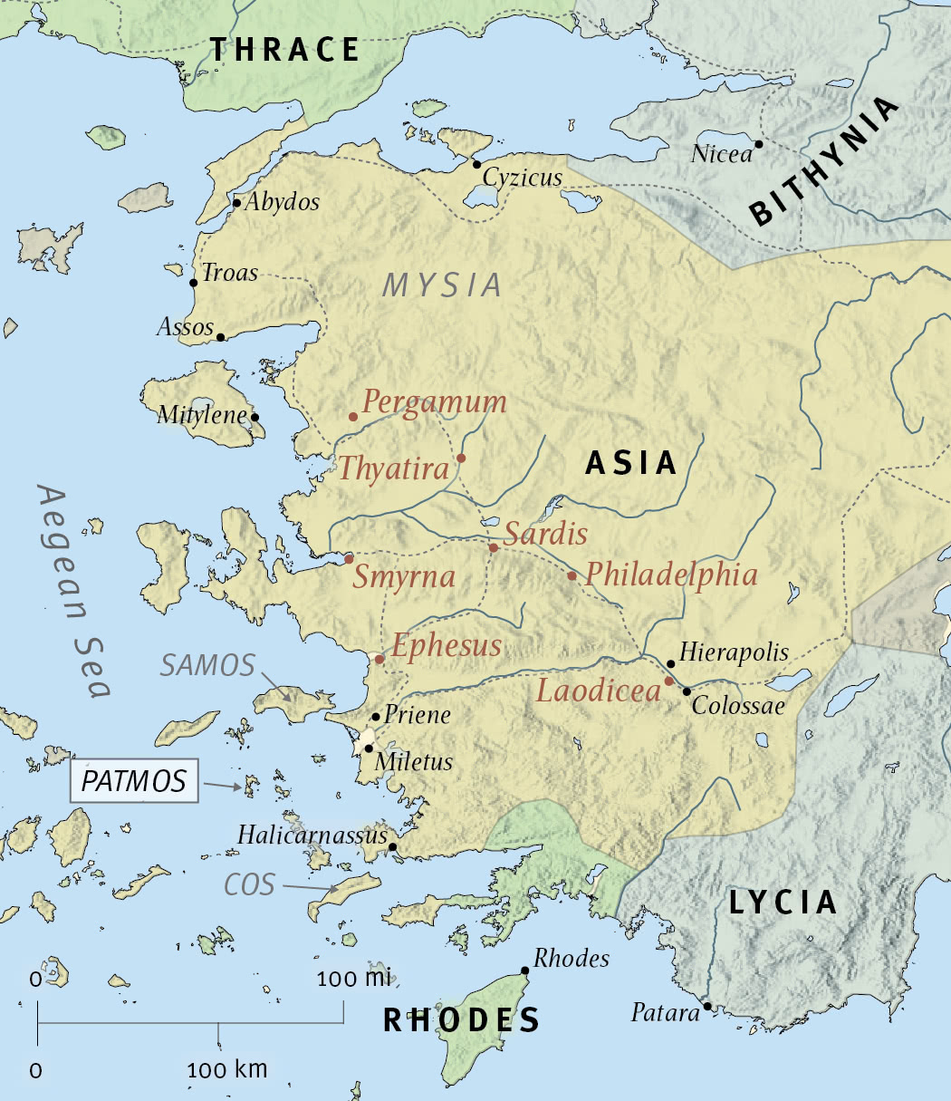

Slide 30
Addressed to the ‘angel’ of the church
Vision of Jesus
Affirmation
Correction
Exhortation
Promise
Invitation

Slide 31
He’s the head of the church!
  Addressed to the ‘angel’ of the church
He reveals himself to us & cares for us
  Vision of Jesus
He affirms before he corrects
  Affirmation
But he does expect things of his people too
  Correction
He calls to repentance, not rejection
  Exhortation
He promises glory
  Promise
He speaks to us all
  Invitation

Slide 33
What does it look like to be a faithful witness?

Slide 34
Love (Ephesus)

Slide 35
You have abandoned the love you had at first. Remember, therefore, from where you have fallen; repent, and do the works you did at first.
- Revelation 2:4-5, ESVUK

Slide 36
Love (Ephesus)

Slide 37
Death (Smyrna)

Slide 38
Be faithful unto death, and I will give you the crown of life.
- Revelation 2:10, ESVUK

Slide 39
Death (Smyrna)

Slide 40
Repentance (Pergamum)

Slide 41
You have some there who hold the teaching of Balaam [and] the Nicolatians. Therefore repent.
- Revelation 2:14-16, ESVUK

Slide 42
Repentance (Pergamum)

Slide 43
Intolerance (Thyatira)

Slide 44
I have this against you, that you tolerate that woman Jezebel.
- Revelation 2:20, ESVUK

Slide 45
Intolerance (Thyatira)

Slide 46
Wakefulness (Sardis)

Slide 47
Wake up, and strengthen what remains and is about to die… If you will not wake up, I will come like a thief.
- Revelation 3:2-3, ESVUK

Slide 48
Wakefulness (Sardis)

Slide 49
Endurance (Philadelphia)

Slide 50
I am coming soon. Hold fast what you have, so that no one may seize your crown.
- Revelation 3:11, ESVUK

Slide 51
Endurance (Philadelphia)

Slide 52
Zeal (Laodicea)

Slide 53
Would that you were either cold or hot! So because you are lukewarm, I will spit you out of my mouth… Those whom I love, I reprove and discipline, so be zealous and repent.
- Revelation 3:15-16, 19, ESVUK

Slide 54
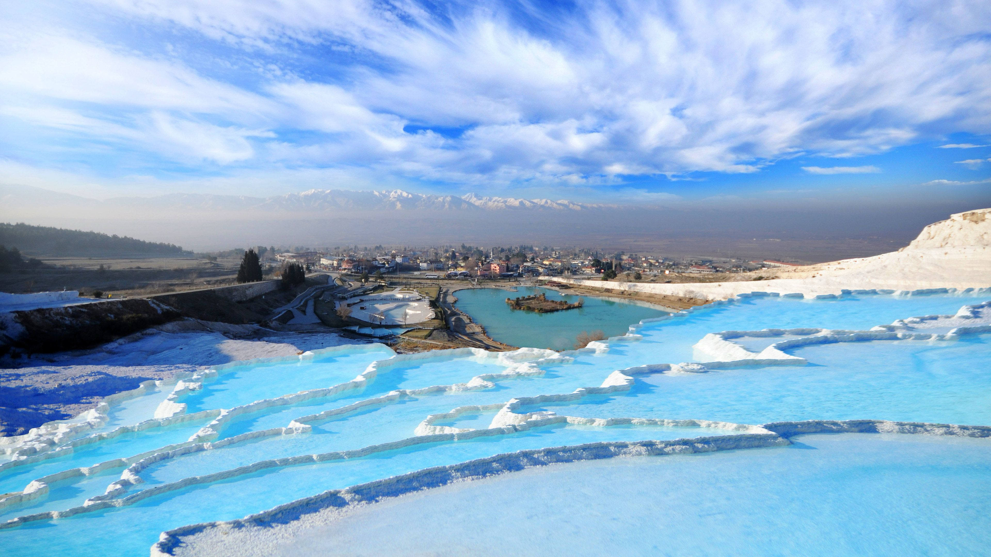

Slide 55
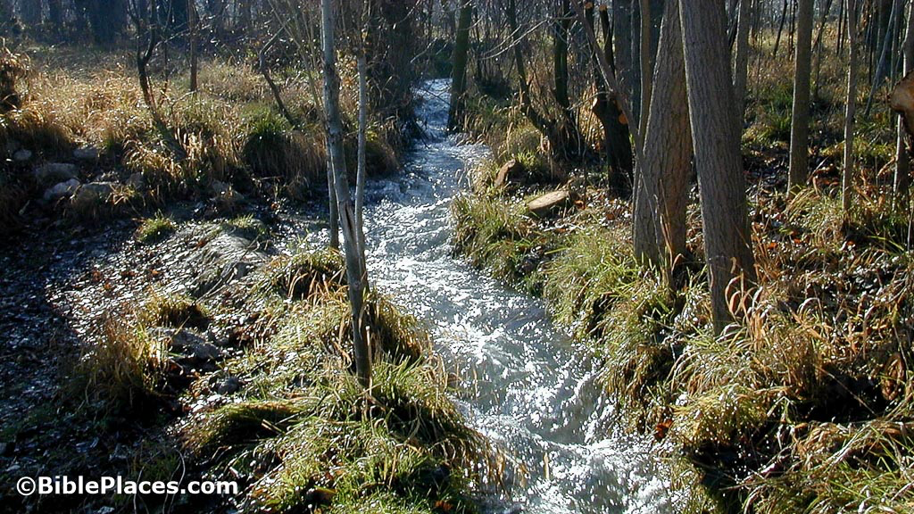

Slide 56
Zeal (Laodicea)

Slide 58
¹ Come, all you who are thirsty,
come to the waters;
and you who have no money,
come, buy and eat!
Come, buy wine and milk
without money and without cost...
³ Give ear and come to me;
listen, that you may live.
- Isaiah 55:1, 3, 6-7, NIVUK

Slide 59
I will make an everlasting covenant with you,
my faithful love promised to David…
⁶ Seek the Lord while he may be found;
call on him while he is near.
⁷ Let the wicked forsake their ways
and the unrighteous their thoughts.
- Isaiah 55:1, 3, 6-7, NIVUK

Slide 60
Let them turn to the Lord,
and he will have mercy on them,
and to our God, for he will freely pardon.
- Isaiah 55:1, 3, 6-7, NIVUK

Slide 62
Nothing in my hand I bring
Simply to the cross I cling
Naked come to thee for dress
Helpless look to thee for grace
Wretched to the fount I fly
Wash me, Saviour, or I die.

