Slide 1
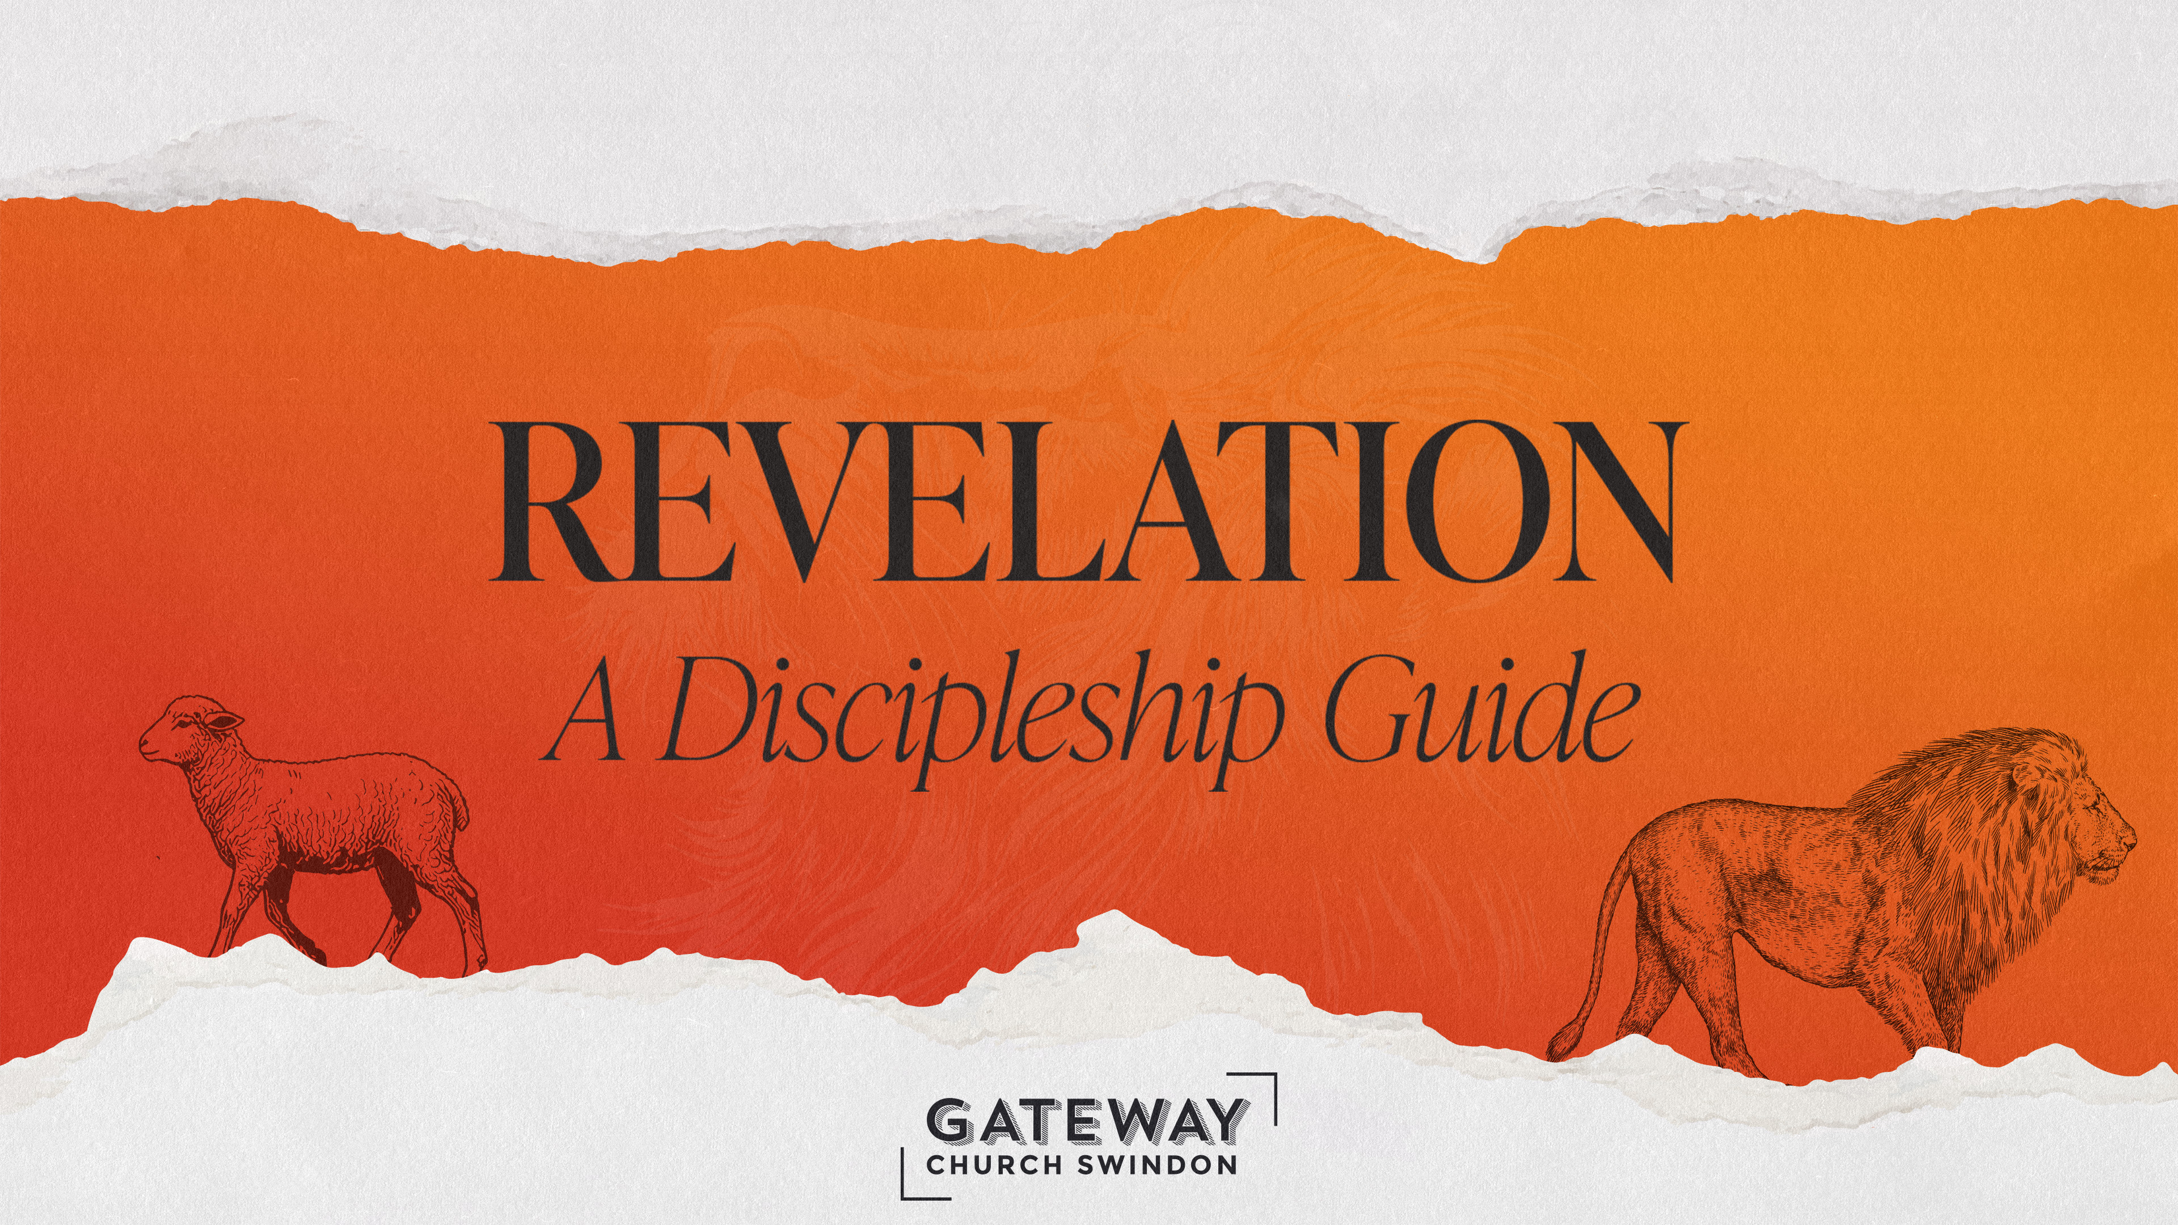

Slide 2
Good
Kingdom of God
Jesus:
  Son of Man (Rev 1:16-20)
  Lion & Lamb (Rev 5)
Faithful Witnesses (e.g. Rev 2 & 3)
God on the Throne (Rev. 5)
Evil
Kingdom of darkness
Babylon (Rev 17 & 18)
Dragon (Rev 12)
Wild Things (Rev 13)

Slide 3
17 Then one of the seven angels who had the seven bowls came and said to me, “Come, I will show you the judgement of the great prostitute who is seated on many waters, ² with whom the kings of the earth have committed sexual immorality, and with the wine of whose sexual immorality the dwellers on earth have become drunk.”
- Revelation 17: 1-7 (ESVUK)
Notes:
Text Gil Sans MT 40
Ref Gil Sans MT 24

Slide 4
³ And he carried me away in the Spirit into a wilderness, and I saw a woman sitting on a scarlet beast that was full of blasphemous names, and it had seven heads and ten horns. ⁴ The woman was arrayed in purple and scarlet, and adorned with gold and jewels and pearls, holding in her hand a golden cup full of abominations and the impurities of her sexual immorality.
- Revelation 17: 1-7 (ESVUK)
Notes:
Text Gil Sans MT 40
Ref Gil Sans MT 24

Slide 5
⁵ And on her forehead was written a name of mystery: “Babylon the great, mother of prostitutes and of earth's abominations.” ⁶ And I saw the woman, drunk with the blood of the saints, the blood of the martyrs of Jesus.
- Revelation 17: 1-7 (ESVUK)
Notes:
Text Gil Sans MT 40
Ref Gil Sans MT 24

Slide 6
When I saw her, I marvelled greatly. ⁷ But the angel said to me, “Why do you marvel? I will tell you the mystery of the woman, and of the beast with seven heads and ten horns that carries her.
- Revelation 17: 1-7 (ESVUK)
Notes:
Text Gil Sans MT 40
Ref Gil Sans MT 24

Slide 7
Notes:
Text Gil Sans MT 40
Ref Gil Sans MT 24

Slide 8
18 After this I saw another angel coming down from heaven, having great authority, and the earth was made bright with his glory. ² And he called out with a mighty voice,
“Fallen, fallen is Babylon the great!
She has become a dwelling place for demons,
a haunt for every unclean spirit,
a haunt for every unclean bird,
a haunt for every unclean and detestable beast.
- Revelation 18: 1-9 (ESVUK)
Notes:
Text Gil Sans MT 40
Ref Gil Sans MT 24

Slide 9
³ For all nations have drunk
the wine of the passion of her sexual immorality,
and the kings of the earth have committed
immorality with her,
and the merchants of the earth have grown rich
from the power of her luxurious living.”
- Revelation 18: 1-9 (ESVUK)
Notes:
Text Gil Sans MT 40
Ref Gil Sans MT 24

Slide 10
⁴ Then I heard another voice from heaven saying,
“Come out of her, my people,
lest you take part in her sins,
lest you share in her plagues;
⁵ for her sins are heaped high as heaven,
and God has remembered her iniquities.
⁶ Pay her back as she herself has paid back others,
and repay her double for her deeds;
mix a double portion for her in the cup she mixed.
- Revelation 18: 1-9 (ESVUK)
Notes:
Text Gil Sans MT 40
Ref Gil Sans MT 24

Slide 11
⁷ As she glorified herself and lived in luxury,
so give her a like measure of torment and mourning,
since in her heart she says,
‘I sit as a queen,
I am no widow,
and mourning I shall never see.’
- Revelation 18: 1-9 (ESVUK)
Notes:
Text Gil Sans MT 40
Ref Gil Sans MT 24

Slide 12
⁸ For this reason her plagues will come in a single day,
death and mourning and famine,
and she will be burned up with fire;
for mighty is the Lord God who has judged her.”
⁹ And the kings of the earth, who committed sexual immorality and lived in luxury with her, will weep and wail over her when they see the smoke of her burning.
- Revelation 18: 1-9 (ESVUK)
Notes:
Text Gil Sans MT 40
Ref Gil Sans MT 24

Slide 13
Notes:
Text Gil Sans MT 40
Ref Gil Sans MT 24

Slide 14
19 After this I heard what seemed to be the loud voice of a great multitude in heaven, crying out,
“Hallelujah!
Salvation and glory and power belong to our God,
² for his judgements are true and just;
for he has judged the great prostitute
who corrupted the earth with her immorality,
and has avenged on her the blood of his servants.”
- Revelation 19: 1-4 (ESVUK)
Notes:
Text Gil Sans MT 40
Ref Gil Sans MT 24

Slide 15
³ Once more they cried out,
“Hallelujah!
The smoke from her goes up for ever and ever.”
⁴ And the twenty-four elders and the four living creatures fell down and worshipped God who was seated on the throne, saying, “Amen. Hallelujah!”
- Revelation 19: 1-4 (ESVUK)
Notes:
Text Gil Sans MT 40
Ref Gil Sans MT 24

Slide 16
Notes:
Text Gil Sans MT 40
Ref Gil Sans MT 24

Slide 17
Revelation 17 & 18 simplified…
Babylon is a city represented by an image of a prostitute sitting on a beast. In the Bible, cities are often used as metaphors for deeper spiritual realities.
Babylon is the city of man. It is evil, immoral, corrupt and idolatrous. It seeks to draw people away from Jesus.
Jesus has and will triumph over Babylon, bringing an end to evil & injustice.

Slide 18
Babylon is…
Filled with luxury and decadence (17:4)
Excessive and indulgent (18:3)
Rich through exploiting others (18:13)
Boastful and seeks its own glory (18:7)
Immoral, unclean and anti-God (18:2)
Murderous and oppressive to God’s people (17:6)
Seductive (17:2, 17:6-8, 17:19)

Slide 19
How do we live in Babylon?
Be ALERT – Don’t be seduced
  “Where am I being seduced?”
Be BOLD – Stand up and speak up
  “Where is God calling me to stand up, stand out and get involved (in love) against injustice, oppression and evil?”
Be CONFIDENT – Babylon falls

Slide 20
Notes:
Text Gil Sans MT 40
Ref Gil Sans MT 24

