Slide 1
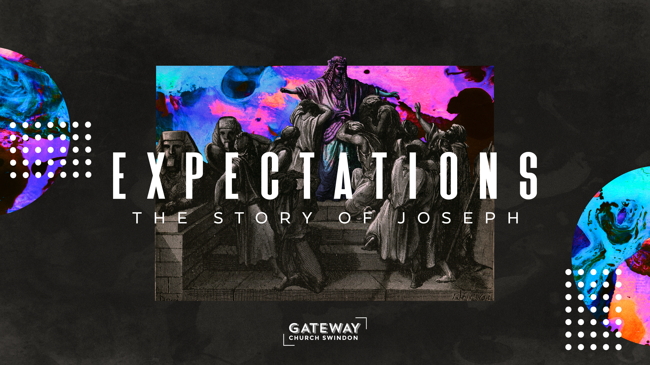

Slide 2
Then he [Jacob] gave them these instructions: “I am about to be gathered to my people. Bury me with my fathers in the cave in the field of Ephron the Hittite, the cave in the field of Machpelah, near Mamre in Canaan, which Abraham bought along with the field as a burial place from Ephron the Hittite.
- Genesis 49v29-30 (NIV)
Notes:
Text Gil Sans MT 40
Ref Gil Sans MT 24

Slide 3
There Abraham and his wife Sarah were buried, there Isaac and his wife Rebekah were buried, and there I buried Leah. The field and the cave in it were bought from the Hittites.” When Jacob had finished giving instructions to his sons, he drew his feet up into the bed, breathed his last and was gathered to his people.
- Genesis 49v31-33 (NIV)
Notes:
Text Gil Sans MT 40
Ref Gil Sans MT 24

Slide 4
Joseph threw himself on his father and wept over him and kissed him.
- Genesis 50v1 (NIV)
Notes:
Text Gil Sans MT 40
Ref Gil Sans MT 24

Slide 5
When Joseph’s brothers saw that their father was dead, they said, “What if Joseph holds a grudge against us and pays us back for all the wrongs we did to him?” So they sent word to Joseph, saying, “Your father left these instructions before he died: ‘This is what you are to say to Joseph: I ask you to forgive your brothers the sins and the wrongs they committed in treating you so badly.’ Now please forgive the sins of the servants of the God of your father.” When their message came to him, Joseph wept.
- Genesis 50v15-17 (NIV)
Notes:
Text Gil Sans MT 40
Ref Gil Sans MT 24

Slide 6
His brothers then came and threw themselves down before him. “We are your slaves,” they said.
But Joseph said to them, “Don’t be afraid. Am I in the place of God? You intended to harm me, but God intended it for good to accomplish what is now being done, the saving of many lives.
- Genesis 50v18-20 (NIV)
Notes:
Text Gil Sans MT 40
Ref Gil Sans MT 24

Slide 7
So then, don’t be afraid. I will provide for you and your children.” And he reassured them and spoke kindly to them. Joseph stayed in Egypt, along with all his father’s family. He lived a hundred and ten years and saw the third generation of Ephraim’s children. Also the children of Makir son of Manasseh were placed at birth on Joseph’s knees.
- Genesis 50v21-23 (NIV)
Notes:
Text Gil Sans MT 40
Ref Gil Sans MT 24

Slide 8
Then Joseph said to his brothers, “I am about to die. But God will surely come to your aid and take you up out of this land to the land he promised on oath to Abraham, Isaac and Jacob.” And Joseph made the Israelites swear an oath and said, “God will surely come to your aid, and then you must carry my bones up from this place.” So Joseph died at the age of a hundred and ten. And after they embalmed him, he was placed in a coffin in Egypt.
- Genesis 50v24-26 (NIV)
Notes:
Text Gil Sans MT 40
Ref Gil Sans MT 24

Slide 10
Different
Harder
Longer
Better
Notes:
Text Gil Sans MT 40
Ref Gil Sans MT 24

Slide 12
This is what you are to say to Joseph: I ask you to forgive your brothers the sins and the wrongs they committed in treating you so badly.
- Genesis 50v17 (NIV)
Notes:
Text Gil Sans MT 40
Ref Gil Sans MT 24

Slide 14
Joseph believes God’s blessing
Joseph sees God’s story
Joseph reaches for reconciliation
Notes:
Text Gil Sans MT 40
Ref Gil Sans MT 24

Slide 15
Joseph believes God’s blessing
Notes:
Text Gil Sans MT 40
Ref Gil Sans MT 24

Slide 16
God will visit you and bring you up out of this land to the land that he swore to Abraham, to Isaac, and to Jacob.
- Genesis 50v24 (NIV)
Notes:
Text Gil Sans MT 40
Ref Gil Sans MT 24

Slide 17
Joseph believes God’s blessing
Notes:
Text Gil Sans MT 40
Ref Gil Sans MT 24

Slide 18
Understand, then, that those who have faith are children of Abraham. Scripture foresaw that God would justify the Gentiles by faith, and announced the gospel in advance to Abraham: “All nations will be blessed through you.” So those who rely on faith are blessed along with Abraham, the man of faith.
- Galatians 3v7-9 (NIV)
Notes:
Text Gil Sans MT 40
Ref Gil Sans MT 24

Slide 19
Joseph sees God’s story
Notes:
Text Gil Sans MT 40
Ref Gil Sans MT 24

Slide 20
Count it all joy, my brothers, when you meet trials of various kinds, for you know that the testing of your faith produces steadfastness. And let steadfastness have its full effect, that you may be perfect and complete, lacking in nothing.
- James 1v2-4 (ESV)
Notes:
Text Gil Sans MT 40
Ref Gil Sans MT 24

Slide 21
Joseph sees God’s story
Notes:
Text Gil Sans MT 40
Ref Gil Sans MT 24

Slide 22
And we know that in all things God works for the good of those who love him, who have been called according to his purpose.
- Romans 8v28 (NIV)
Notes:
Text Gil Sans MT 40
Ref Gil Sans MT 24

Slide 23
Joseph sees God’s story
Notes:
Text Gil Sans MT 40
Ref Gil Sans MT 24

Slide 24
v2 “…The Lord was with Joseph so that he prospered”
v3 “the Lord gave him success in everything he did” v21 “The Lord was with Joseph; he showed him kindness and granted him favour in the eyes of the prison warden”
v23 “the Lord was with Joseph and gave him success in whatever he did.”
- Genesis 39 (NIV)
Notes:
Text Gil Sans MT 40
Ref Gil Sans MT 24

Slide 25
Joseph sees God’s story
Notes:
Text Gil Sans MT 40
Ref Gil Sans MT 24

Slide 26
“You can never learn that Christ is all you need, until Christ is all you have.”
- Corrie ten Boom
Notes:
Text Gil Sans MT 40
Ref Gil Sans MT 24

Slide 27
Joseph sees God’s story
Notes:
Text Gil Sans MT 40
Ref Gil Sans MT 24

Slide 28
“In the darkest night of the soul, Christians have something to hold onto that Job [or Joseph] never knew – we know Christ crucified. Christians have learned that when there seems to be no other evidence of God’s love, they cannot escape the cross. “He who did not spare his own Son but gave him up for us all – how will he not also, along with him, graciously give us all things?”… When we suffer there will sometimes be mystery. Will there also be faith? Yes, if our attention is focused more on the cross and on the God of the cross than on the suffering itself”.
- Don Carson, How Long, O Lord?: Reflections on Suffering and Evil
Notes:
Text Gil Sans MT 40
Ref Gil Sans MT 24

Slide 29
Joseph sees God’s story
Notes:
Text Gil Sans MT 40
Ref Gil Sans MT 24

Slide 30
Joseph reaches for reconciliation
Notes:
Text Gil Sans MT 40
Ref Gil Sans MT 24

Slide 31
All this is from God, who reconciled us to himself through Christ and gave us the ministry of reconciliation: …We are therefore Christ’s ambassadors, as though God were making his appeal through us. We implore you on Christ’s behalf: Be reconciled to God.
- 2 Corinthians 5v18-20 (NIV)
Notes:
Text Gil Sans MT 40
Ref Gil Sans MT 24

Slide 32
Joseph reaches for reconciliation
Notes:
Text Gil Sans MT 40
Ref Gil Sans MT 24

Slide 33
“Reconciliation is about how to relate even after forgiveness and justice have occurred. It’s about how to delve even deeper into relationship with one another. An absence of hostility is possible without a spiritual dimension, but reconciliation is not. Reconciliation is possible only if we approach it primarily as a spiritual process that requires a posture of hope in the reconciling work of Christ and a commitment from the church to both be and proclaim this type of reconciled community.”
- Dr Brenda Salter McNeil, theologian
Notes:
Text Gil Sans MT 40
Ref Gil Sans MT 24

Slide 34
Joseph reaches for reconciliation
Notes:
Text Gil Sans MT 40
Ref Gil Sans MT 24

Slide 35
When their message came to him, Joseph wept. His brothers then came and threw themselves down before him. “We are your slaves,” they said.
But Joseph said to them, “Don’t be afraid. Am I in the place of God? You intended to harm me, but God intended it for good to accomplish what is now being done, the saving of many lives.
- Genesis 50v17b-20 (NIV)
Notes:
Text Gil Sans MT 40
Ref Gil Sans MT 24

Slide 36
Joseph reaches for reconciliation
Notes:
Text Gil Sans MT 40
Ref Gil Sans MT 24

Slide 37
In the same way the Spirit helps us in our weakness. We do not know what we ought to pray for, but the Spirit himself intercedes for us through wordless groans.
- Romans 8v26 (NIV)
Notes:
Text Gil Sans MT 40
Ref Gil Sans MT 24

Slide 38
“There is no pit so deep that He is not deeper still.”
- Betsie ten Boom
Notes:
Text Gil Sans MT 40
Ref Gil Sans MT 24

