Slide 1
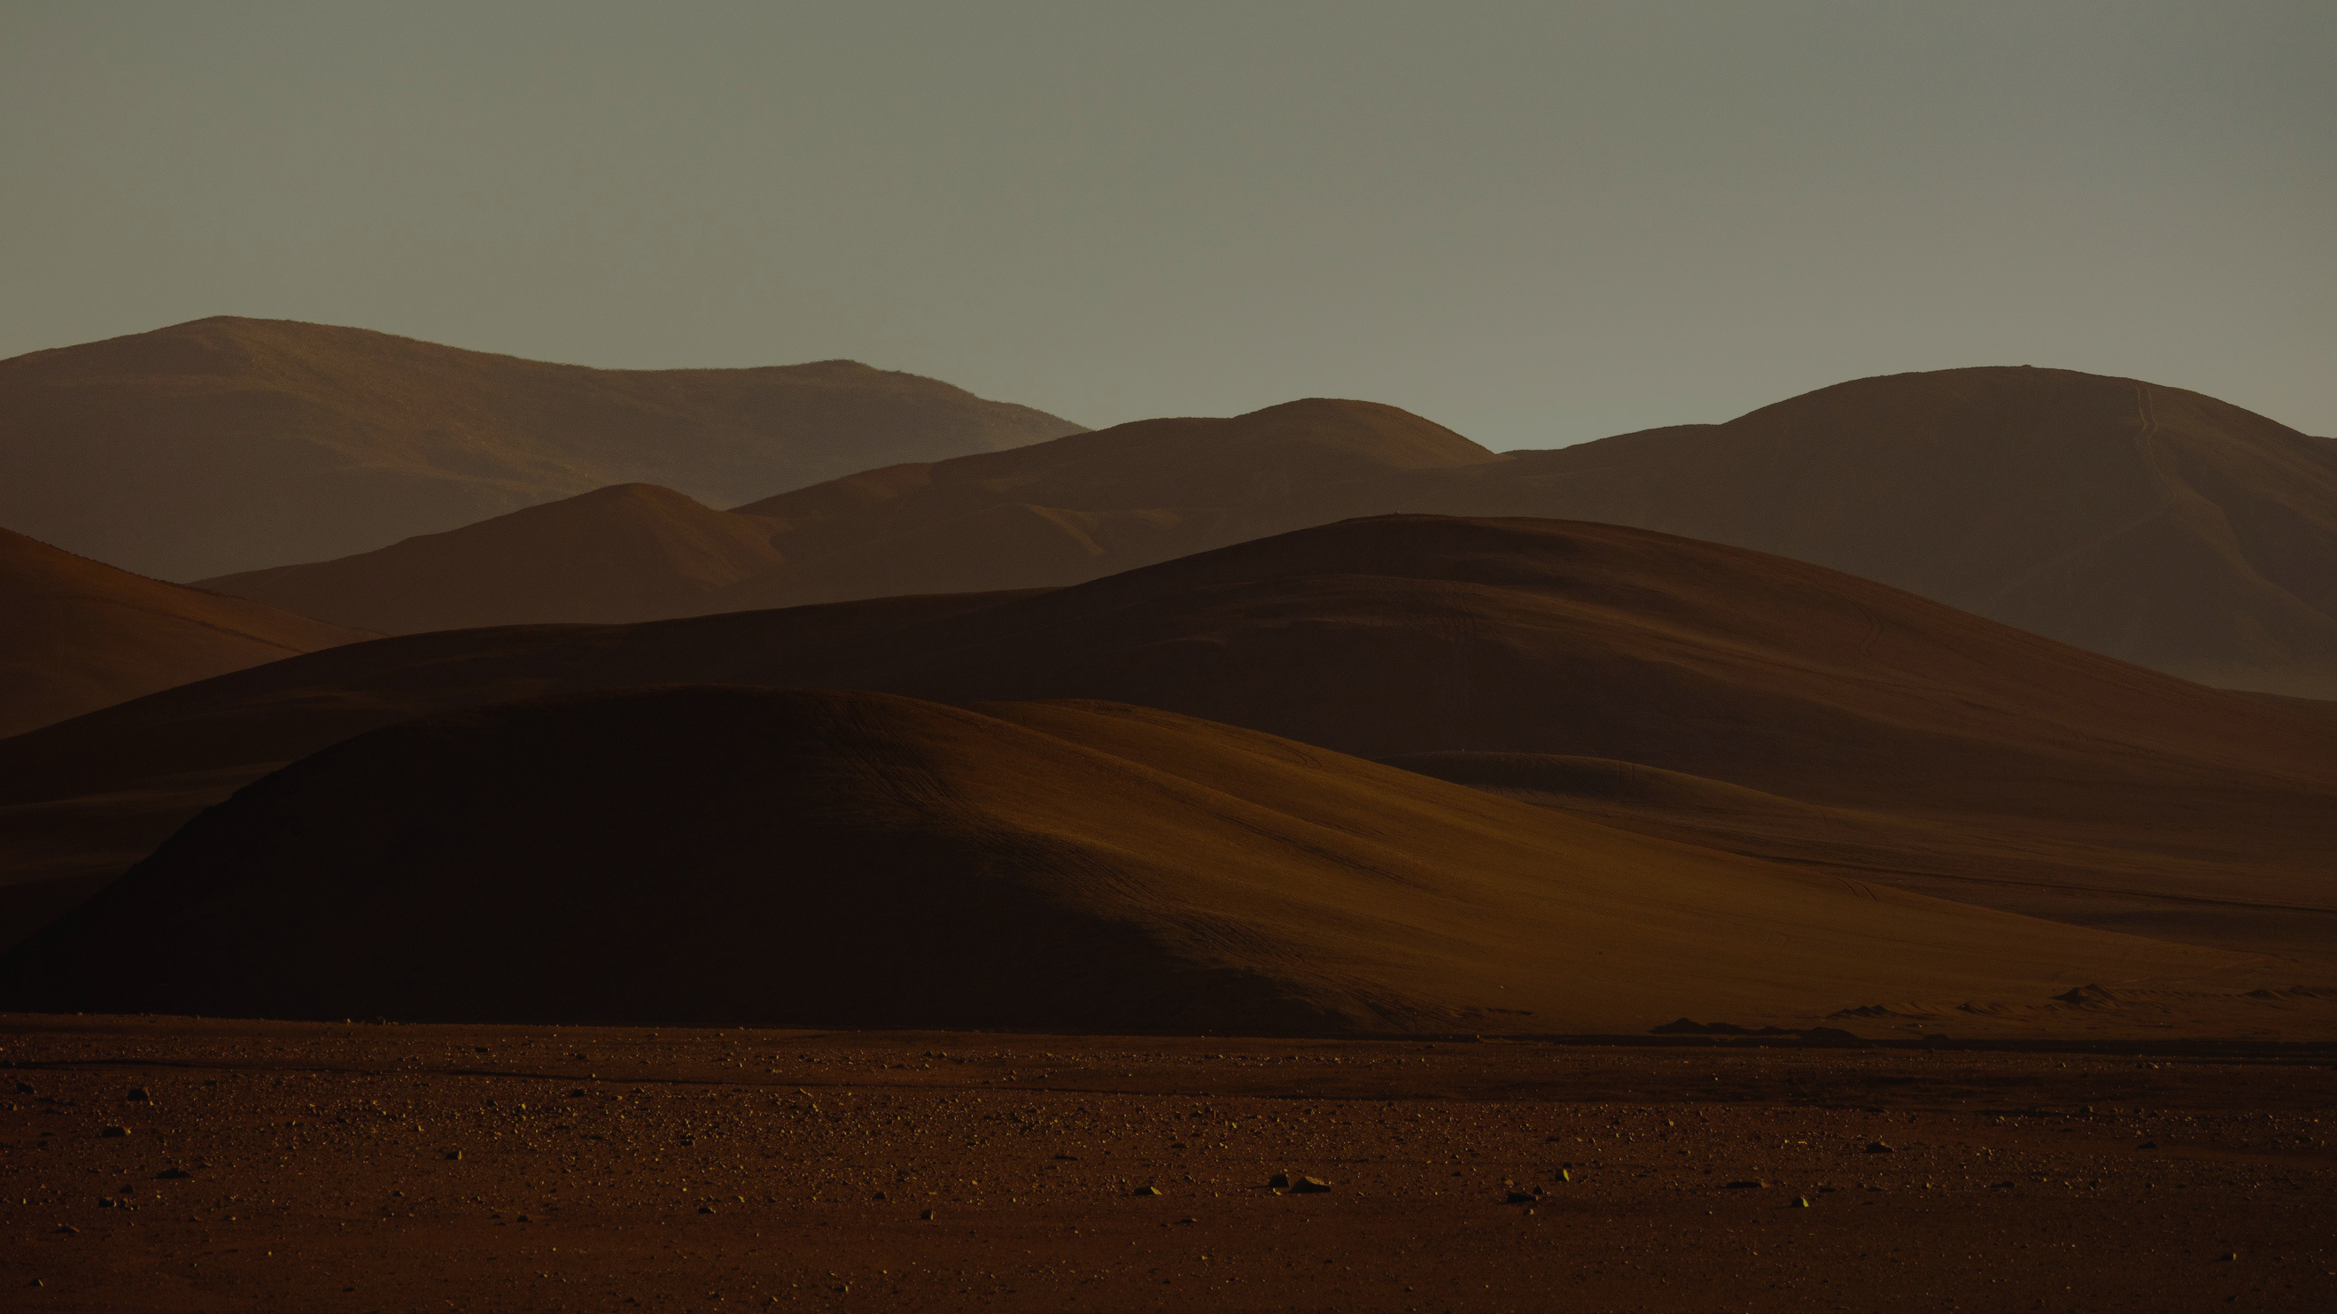

ABRAHAM'S FAITH
FRIEND OF GOD

Slide 2
Making God
Fit to Us
Genesis 16:1-16

Slide 3
ABRAHAM'S FAITH
Now Sarai, Abram's wife, had borne him no children. She had a female Egyptian servant whose name was Hagar. And Sarai said to Abram, “Behold now, the Lord has prevented me from bearing children. Go in to my servant;
Genesis 16:1-2

Slide 4
ABRAHAM'S FAITH
Convincing ourselves that wrong is right
It starts with impatience with God

Slide 5
ABRAHAM'S FAITH
Go in to my servant;
it may be that I shall obtain children by her.”
Genesis 16:1-2

Slide 6
ABRAHAM'S FAITH
Convincing ourselves that wrong is right
It starts with impatience with God
Then we rationalize disobedience to God
“If servant is yours…

Slide 7
ABRAHAM'S FAITH
What is wrong?
#1. It is violating their marriage vow

Slide 8
ABRAHAM'S FAITH
What is wrong?
#1. It is violating their marriage vow
#2. Not trusting God to make it happen

Slide 9
ABRAHAM'S FAITH
Why she thought it was ok?
#1. She knows God’s goal, if she is helping reach the goal then it is ok.

Slide 10
ABRAHAM'S FAITH
Why she thought it was ok?
#1. She knows God’s goal, if she is helping reach the goal then it is ok.
#2. She has a love for Abram

Slide 11
ABRAHAM'S FAITH
So, after Abram had lived ten years in the land of Canaan, Sarai, Abram's wife, took Hagar the Egyptian, her servant, and gave her to Abram her husband as a wife.
Genesis 16:3

Slide 12
ABRAHAM'S FAITH
Convincing ourselves that wrong is right
It starts with impatience with God
Then we rationalize disobedience to God
It ends in failure to trust God

Slide 13
ABRAHAM'S FAITH
And he went in to Hagar, and she conceived. And when she saw that she had conceived, she looked with contempt on her mistress.
Genesis 16:4

Slide 14
ABRAHAM'S FAITH
And Sarai said to Abram, “May the wrong done to me be on you! I gave my servant to your embrace, and when she saw that she had conceived, she looked on me with contempt. May the Lord judge between you and me!”
Genesis 16:5

Slide 15
ABRAHAM'S FAITH
But Abram said to Sarai, “Behold, your servant is in your power; do to her as you please.” Then Sarai dealt harshly with her, and she fled from her.
Genesis 16:6

Slide 16
ABRAHAM'S FAITH
The fall out of trying to help God with his plan:
Hagar has contempt for Sarai
Sarai’s pride is wounded—blames Abram
Abram doesn’t deal with it, passes the buck
Sarai deals harshly with Hagar
Hagar runs away

Slide 17
ABRAHAM'S FAITH
II. There are Consequences to Unbelief
Our sin often brings disaster on others

Slide 18
ABRAHAM'S FAITH
II. There are Consequences to Unbelief
Our sin often brings disaster on others
We often blame others for our own sin

Slide 19
ABRAHAM'S FAITH
II. There are Consequences to Unbelief
Our sin often brings disaster on others
We often blame others for our own sin
If we don’t take ownership we condition ourselves to repeat the failure

Slide 20
ABRAHAM'S FAITH
The angel of the Lord found her by a spring of water in the wilderness, the spring on the way to Shur. And he said, “Hagar, servant of Sarai, where have you come from and where are you going?”
Genesis 16:7-8

Slide 21
ABRAHAM'S FAITH
III. The Compassion of God surprises us
The Grace of God pursues us
the Angel of the LORD

Slide 22
ABRAHAM'S FAITH
The angel of the Lord said to her, “Return to your mistress and submit to her.”
Genesis 16:9

Slide 23
ABRAHAM'S FAITH
III. The Compassion of God surprises us
The Grace of God pursues us
The Word of God re-directs us
return and submit

Slide 24
ABRAHAM'S FAITH
The angel of the Lord also said to her, “I will surely multiply your offspring so that they cannot be numbered for multitude.”
Genesis 16:10

Slide 25
ABRAHAM'S FAITH
III. The Compassion of God surprises us
The Grace of God pursues us
The Word of God re-directs us
The Love of God reaffirms us
I will…multiply

Slide 26
ABRAHAM'S FAITH
And the angel of the LORD said to her,
“Behold, you are pregnant
and shall bear a son.
You shall call his name Ishmael,
Because the Lord has listened to your affliction.
Genesis 16:11-12

Slide 27
ABRAHAM'S FAITH
He shall be a wild donkey of a man,
His hand against everyone
And everyone’s hand against him,
And he shall dwell over against all his kinsmen.
Genesis 16:11-12

Slide 28
ABRAHAM'S FAITH
III. The Compassion of God surprises us
The Grace of God pursues us
The Word of God re-directs us
The Love of God reaffirms us
The Promise of God protects us
You shall…he shall

Slide 29
ABRAHAM'S FAITH
III. The Compassion of God surprises us
The Grace of God pursues us
The Word of God re-directs us
The Love of God reaffirms us
The Promise of God protects us
Our Obedience to God overjoys us

Slide 30
ABRAHAM'S FAITH
So she called the name of the LORD who spoke to her, “You are a God of seeing,” for she said, “Truly here I have seen him who looks after me.”
Genesis 16:13-16

Slide 31
ABRAHAM'S FAITH
Therefore the well was called
Beer-lahai-roi;
it lies between Kadesh and Bered.
Genesis 16:13-16

Slide 32
ABRAHAM'S FAITH
And Hagar bore Abram a son, and Abram called the name of his son, whom Hagar bore, Ishmael. Abram was eighty-six years old when Hagar bore Ishmael to Abram.
Genesis 16:13-16

Slide 33
Called Into Faith
Faith builds over a lifetime, but is birthed in a moment.

