Slide 1
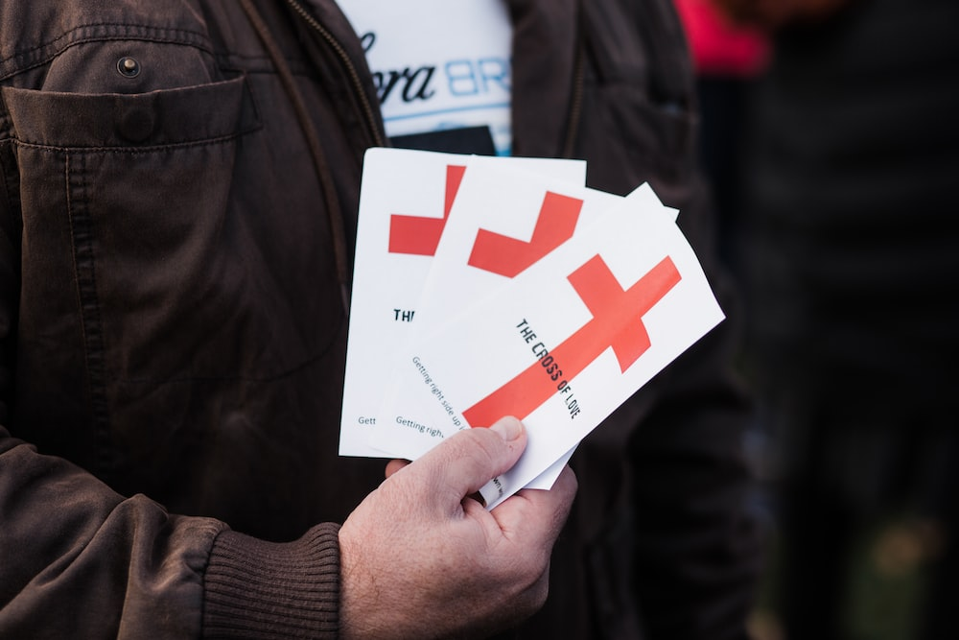
7 Reminders About Witnessing
Colossians 4:2-6

Slide 2
Big idea:
Sharing the gospel often looks like a waste. We’ll will never see, in this life, all the good that our witnessing has done in God’s providence. Just keep sowing, praying, & trusting.

Slide 3
How many people would be saved if God answered all of our prayers today?
Witnessing begins in prayer (4:2)

Slide 4
Were it not for our belief in the sovereignty of God, we would be hopeless.
2. Witnessing requires open doors (4:3a)

Slide 5
Share the gospel at all times & use necessary words (Rom. 10:14-17).
3. Witnessing demands speaking up (4:3b)

Slide 6
In God’s providence & plan, sometimes we see more clearly the purpose of our troubles—and, sometimes, we don’t.
4. Witnessing involves personal sacrifice (4:3c)

Slide 7
The gospel demands that the messenger makes himself clear not clever.
5. Witnessing involves godly wisdom (4:4)

Slide 8
When it comes to the gospel, many Christians just click ‘like’ instead of ‘share.'
6. Witnessing involves godly living (4:5)

Slide 9
We need to speak truth - but too often people also use truth as a weapon…and that doesn't honor Jesus.
7. Witnessing calls for gracious words (4:6)

