Slide 1

Stewardship
in
Steps

Slide 2
Judge not, and you will not be judged; condemn not, and you will not be condemned; forgive, and you will be forgiven; Luke 6:37-38

Slide 3
Give, and it will be given to you. Good measure, pressed down, shaken together, running over, will be put into your lap. For with the measure you use it will be measured back to you. Luke 6:37-38

Slide 4
Generous Givers
Steps:
Grace

Slide 5
I. Man’s Ordinary Rules for Life

Slide 6
“If you love those who love you, what benefit is that to you? For even sinners love those who love them. And if you do good to those who do good to you, what benefit is that to you? For even sinners do the same. Luke 6:32-33

Slide 7
I. Man’s Ordinary Rules for Life
Like for Like

Slide 8
And if you lend to those from whom you expect to receive, what credit is that to you? Even sinners lend to sinners, to get back the same amount. Luke 6:34

Slide 9
I. Man’s Ordinary Rules for Life
Like for Like
Lend but return

Slide 10
But love your enemies, and do good, and lend, expecting nothing in return, and your reward will be great, and you will be sons of the Most High, for he is kind to the ungrateful and the evil. Be merciful, even as your Father is merciful. Luke 6:35-36

Slide 11
I. Man’s Ordinary Rules for Life
Like for Like
The devilish and divine
Lend but return

Slide 12
But love your enemies, and do good, and lend, expecting nothing in return, and your reward will be great, and you will be sons of the Most High, for he is kind to the ungrateful and the evil. Be merciful, even as your Father is merciful. Luke 6:35-36

Slide 13
II. God’s Divine Rules for Life
Give love without return

Slide 14
Divine vs. Man’s Rules for Life
Give love without return
(Divine)
Give Love when you get Love
(Like for Like)

Slide 15
But love your enemies, and do good, and lend, expecting nothing in return, and your reward will be great, and you will be sons of the Most High, for he is kind to the ungrateful and the evil. Be merciful, even as your Father is merciful. Luke 6:35-36

Slide 16
II. God’s Divine Rules for Life
Give love without return
Do Good without return

Slide 17
Divine vs. Man’s Rules for Life
Do good for Divine’s sake
Do good when they are good to you

Slide 18
But love your enemies, and do good, and lend, expecting nothing in return, and your reward will be great, and you will be sons of the Most High, for he is kind to the ungrateful and the evil. Be merciful, even as your Father is merciful. Luke 6:35-36

Slide 19
II. God’s Divine Rules for Life
Give love without return
Give money without return
Do Good without return

Slide 20
Divine vs. Man’s Rules for Life
Lend without expectation
Lend with expectation

Slide 21
…and your reward will be great, and you will be sons of the Most High, for he is kind to the ungrateful and the evil. Be merciful, even as your Father is merciful. Luke 6:35b-36

Slide 22
…and your reward will be great, and you will be sons of the Most High, for he is kind to the ungrateful and the evil. Be merciful, even as your Father is merciful. Luke 6:35b-36

Slide 23
“Judge not, and you will not be judged; condemn not, and you will not be condemned; forgive, and you will be forgiven; give, and it will be given to you. Luke 6:37-38a

Slide 24
III. Grandest Quality Seen in Christians
Grace for perceived shortcomings

Slide 25
“Judge not, and you will not be judged; condemn not, and you will not be condemned; forgive, and you will be forgiven; give, and it will be given to you. Luke 6:37-38a

Slide 26
III. Grandest Quality Seen in Christians
Grace for perceived shortcomings
Grace for painful offenses

Slide 27
“Judge not, and you will not be judged; condemn not, and you will not be condemned; forgive, and you will be forgiven; give, and it will be given to you. Luke 6:37-38a

Slide 28
III. Grandest Quality Seen in Christians
Grace for perceived shortcomings
Grace for giving back to God
Grace for painful offenses

Slide 29
Give, and it will be given to you. Good measure, pressed down, shaken together, running over, will be put into your lap. For with the measure you use it will be measured back to you. Luke 6:37-38

Slide 30
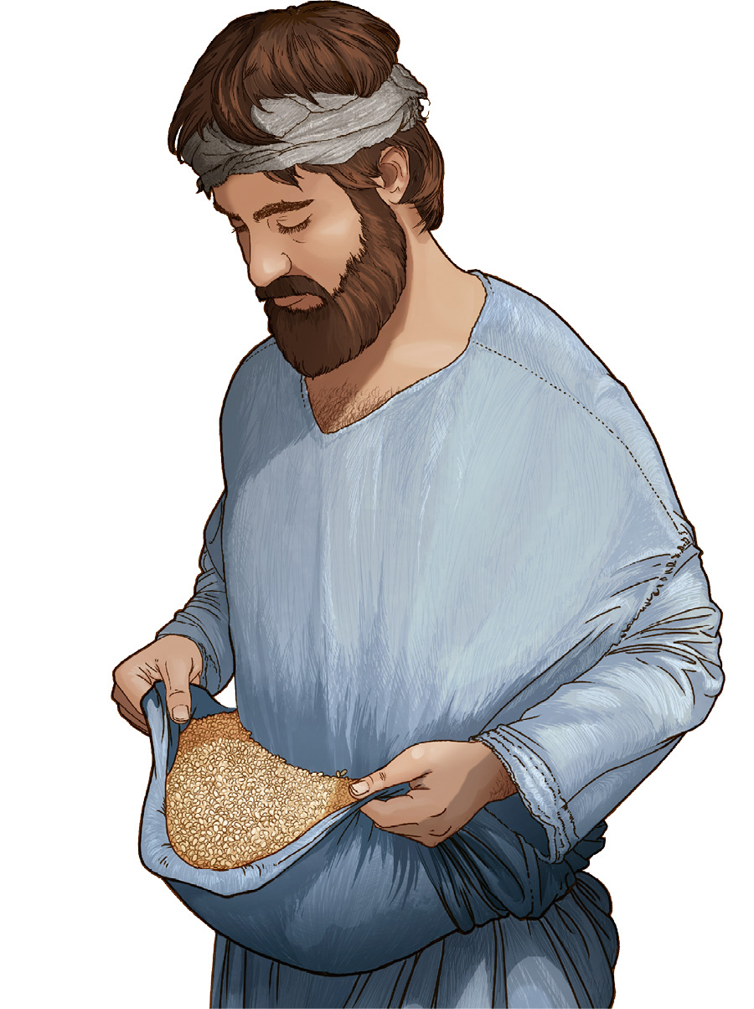



Slide 31
Active Givers
Steps:
First

Slide 32
Acceptable Givers
Steps:
Faith

Slide 33
Generous Givers
Leaps:
Big

Slide 34
First Time Givers
Regular Givers
Striving to Tithe & Beyond

Slide 35
First Time Givers
Regular Givers
Striving to Tithe
& Beyond

