Slide 1
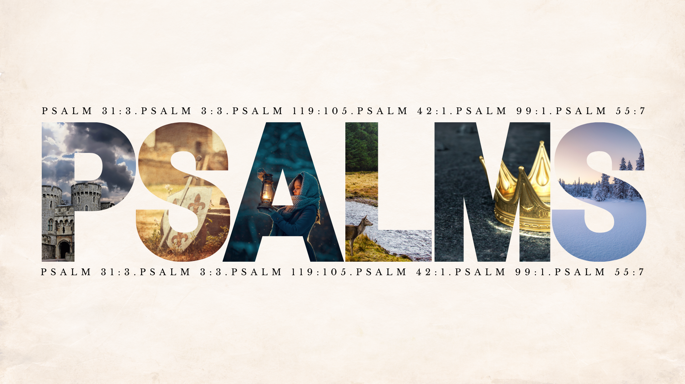

Slide 2

Psalm 62
Big idea: Absolute confidence in God
Verses 1-2: Here’s who God is.
Verses 3-4: Yes, there are antagonistic people in this world, don’t despair.
Verses 5-8: Here’s who God is.
Verses 9-10: Yes, there are temptations to be confident in besides God, don’t place your security in them.
Verses 11-12: Here’s who God is.

Slide 3
Psalm 62:1
“Dumiyyah: Far from passive muteness, it is poised, reverent silence…refusing to be agitated by external tumult … it calls the believer to still every competing voice, giving the floor to God alone.”
Psalm 65:1 (NASB)
Acts 11:17-18

Slide 4
Psalm 62:2
62:2 He is my rock/I shall not be greatly shaken (cast off course, fallen in decay)
  Psalm 15:5b; Psalm 16:8; Psalm 55:22
“a sea in a light breeze, fluctuating to a degree, not swollen into billows.”
  Proverbs 24:16; Ephesians 4:14

Slide 5
Psalm 62:5-8
Trust in Him: placing one’s full weight upon someone or something with calm assurance (Psalm 13:5; Proverbs 3:5; Isaiah 30:15)
He is our refuge (20 uses in Scripture)
13 in Psalms & Proverbs → God as our refuge directly affects our praise, prayers, and wisdom (Psalm 46:1-3)
6 in passages about end times → God as our refuge is rooted in eternity and He is the only eternal shelter (Isaiah 25:1, 4; Joel 3:16)

Slide 6
Psalm 62:9-12
Don’t look for your foundational security in anything of this life; it’s all temporary.
Scripture exposes misplaced בָּטח (trust) in accumulated assets
  Psalm 20:7 & Jeremiah 48:7
Psalm 90:9-12; Ecclesiastes 3:20

Slide 7
This Week Let’s All
Read: Psalm 65; Micah 4 & 5; 2 Thessalonians 2
Pray: As led by the Holy Spirit and Scripture
Remember: Psalm 7:10
Reflect: Finish this statement. “My trust in God became real when: __________.” or “God proved Himself my refuge and rock when: _________.”
Practice: Spend 10 minutes in silence in one sitting by the end of the week.
Next Week’s Sermon: Intro to Habakkuk

Slide 8
Dumiyyah
a purposeful quietness—a still, expectant hush that looks to God…Silence is restful because faith has settled the issue of trust: ‘my salvation comes from Him.’

