Slide 1


Slide 2
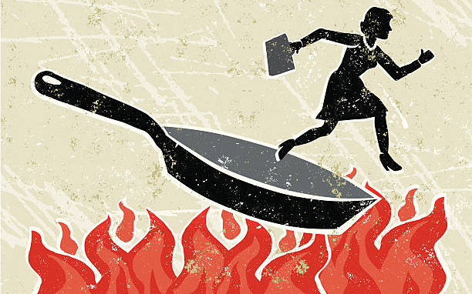


Slide 3


Slide 4
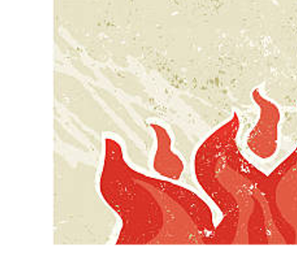

Slide 5


Slide 6
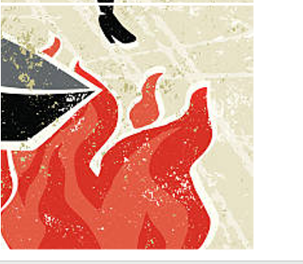

Slide 7


Slide 8


Slide 9
From the frying pan into the fire

Slide 11
Expectations
Notes:
Text Gil Sans MT 40
Ref Gil Sans MT 24

Slide 12
Expectations
Different
Notes:
Text Gil Sans MT 40
Ref Gil Sans MT 24

Slide 13
Expectations
Different
Harder
Notes:
Text Gil Sans MT 40
Ref Gil Sans MT 24

Slide 14
From the frying pan into the fire

Slide 16
²¹ But the Lord was with Joseph and showed him mercy, and He gave him favor in the sight of the keeper of the prison.
²² And the keeper of the prison committed to Joseph’s hand all the prisoners who were in the prison; whatever they did there, it was his doing.
- Genesis 39: 21- 23 (NKJV)
Notes:
Text Gil Sans MT 40
Ref Gil Sans MT 24

Slide 17
²³ The keeper of the prison did not look into anything that was under Joseph’s authority, because the Lord was with him; and whatever he did, the Lord made it prosper.
- Genesis 39: 21- 23 (NKJV)
Notes:
Text Gil Sans MT 40
Ref Gil Sans MT 24

Slide 18
What are the 4 actions of God, in this passage?
What are the 2 actions of the keeper of the prison?
What did the prisoners do?
What did Joseph do?
- Genesis 39: 21- 23 (NKJV)
Notes:
Text Gil Sans MT 40
Ref Gil Sans MT 24

Slide 19
²¹ But the Lord was with Joseph and showed him mercy, and He gave him favor in the sight of the keeper of the prison.
²² And the keeper of the prison committed to Joseph’s hand all the prisoners who were in the prison; whatever they did there, it was his doing.
- Genesis 39: 21- 23 (NKJV)
Notes:
Text Gil Sans MT 40
Ref Gil Sans MT 24

Slide 20
²³ The keeper of the prison did not look into anything that was under Joseph’s authority, because the Lord was with him; and whatever he did, the Lord made it prosper.
- Genesis 39: 21- 23 (NKJV)
Notes:
Text Gil Sans MT 40
Ref Gil Sans MT 24

Slide 21
²¹ But the Lord was with Joseph and showed him mercy, and He gave him favor in the sight of the keeper of the prison.
²² And the keeper of the prison committed to Joseph’s hand all the prisoners who were in the prison; whatever they did there, it was his doing.
- Genesis 39: 21- 23 (NKJV)
Notes:
Text Gil Sans MT 40
Ref Gil Sans MT 24

Slide 22
²³ The keeper of the prison did not look into anything that was under Joseph’s authority, because the Lord was with him; and whatever he did, the Lord made it prosper.
- Genesis 39: 21- 23 (NKJV)
Notes:
Text Gil Sans MT 40
Ref Gil Sans MT 24

Slide 23
²¹ But the Lord was with Joseph and showed him mercy, and He gave him favor in the sight of the keeper of the prison.
²² And the keeper of the prison committed to Joseph’s hand all the prisoners who were in the prison; whatever they did there, it was his doing.
- Genesis 39: 21- 23 (NKJV)
Notes:
Text Gil Sans MT 40
Ref Gil Sans MT 24

Slide 24
²³ The keeper of the prison did not look into anything that was under Joseph’s authority, because the Lord was with him; and whatever he did, the Lord made it prosper.
- Genesis 39: 21- 23 (NKJV)
Notes:
Text Gil Sans MT 40
Ref Gil Sans MT 24

Slide 26
It came to pass after these things that the butler and the baker of the king of Egypt offended their lord, the king of Egypt. ² And Pharaoh was angry with his two officers, the chief butler and the chief baker.
³ So he put them in custody in the house of the captain of the guard, in the prison, the place where Joseph was confined.
- Genesis 40 (NKJV)
Notes:
Text Gil Sans MT 40
Ref Gil Sans MT 24

Slide 27
⁴ And the captain of the guard charged Joseph with them, and he served them; so they were in custody for a while.
⁵ Then the butler and the baker of the king of Egypt, who were confined in the prison, had a dream, both of them, each man’s dream in one night and each man’s dream with its own interpretation.
- Genesis 40 (NKJV)
Notes:
Text Gil Sans MT 40
Ref Gil Sans MT 24

Slide 28
⁶ And Joseph came in to them in the morning and looked at them and saw that they were sad. ⁷ So he asked Pharaoh’s officers who were with him in the custody of his lord’s house, saying, “Why do you look so sad today?”
- Genesis 40 (NKJV)
Notes:
Text Gil Sans MT 40
Ref Gil Sans MT 24

Slide 29
⁸ And they said to him, “We each have had a dream, and there is no interpreter of it.” So Joseph said to them, “Do not interpretations belong to God? Tell them to me, please.”
- Genesis 40 (NKJV)
Notes:
Text Gil Sans MT 40
Ref Gil Sans MT 24

Slide 30
⁹ Then the chief butler told his dream to Joseph, and said to him, “Behold, in my dream a vine was before me, ¹⁰ and in the vine were three branches; it was as though it budded, its blossoms shot forth, and its clusters brought forth ripe grapes.
- Genesis 40 (NKJV)
Notes:
Text Gil Sans MT 40
Ref Gil Sans MT 24

Slide 31
¹¹ Then Pharaoh’s cup was in my hand; and I took the grapes and pressed them into Pharaoh’s cup, and placed the cup in Pharaoh’s hand.”
¹² And Joseph said to him, “This is the interpretation of it: The three branches are three days.
- Genesis 40 (NKJV)
Notes:
Text Gil Sans MT 40
Ref Gil Sans MT 24

Slide 32
¹³ Now within three days Pharaoh will lift up your head and restore you to your place, and you will put Pharaoh’s cup in his hand according to the former manner, when you were his butler.
- Genesis 40 (NKJV)
Notes:
Text Gil Sans MT 40
Ref Gil Sans MT 24

Slide 33
¹⁴ But remember me when it is well with you, and please show kindness to me; make mention of me to Pharaoh and get me out of this house. ¹⁵ For indeed I was stolen away from the land of the Hebrews; and also I have done nothing here that they should put me into the dungeon.”
- Genesis 40 (NKJV)
Notes:
Text Gil Sans MT 40
Ref Gil Sans MT 24

Slide 34
¹⁶ When the chief baker saw that the interpretation was good, he said to Joseph, “I also was in my dream, and there were three white baskets on my head. ¹⁷ In the uppermost basket were all kinds of baked goods for Pharaoh, and the birds ate them out of the basket on my head.”
- Genesis 40 (NKJV)
Notes:
Text Gil Sans MT 40
Ref Gil Sans MT 24

Slide 35
¹⁸ So Joseph answered and said, “This is the interpretation of it: The three baskets are three days. ¹⁹ Within three days Pharaoh will lift off your head from you and hang you on a tree; and the birds will eat your flesh from you.”
- Genesis 40 (NKJV)
Notes:
Text Gil Sans MT 40
Ref Gil Sans MT 24

Slide 36
²⁰ Now it came to pass on the third day, which was Pharaoh’s birthday, that he made a feast for all his servants; and he lifted up the head of the chief butler and of the chief baker among his servants. ²¹ Then he restored the chief butler to his butlership again, and he placed the cup in Pharaoh’s hand.
- Genesis 40 (NKJV)
Notes:
Text Gil Sans MT 40
Ref Gil Sans MT 24

Slide 37
²² But he hanged the chief baker, as Joseph had interpreted to them. ²³ Yet the chief butler did not remember Joseph, but forgot him.
- Genesis 40 (NKJV)
Notes:
Text Gil Sans MT 40
Ref Gil Sans MT 24

Slide 39
⁴ And the captain of the guard charged Joseph with them, and he served them; so they were in custody for a while.
- Genesis 40: 4 (NKJV)
Notes:
Text Gil Sans MT 40
Ref Gil Sans MT 24

Slide 40
²⁶ Yet it shall not be so among you; but whoever desires to become great among you, let him be your servant.
²⁷ And whoever desires to be first among you, let him be your slave—
²⁸ just as the Son of Man did not come to be served, but to serve, and to give His life a ransom for many.”
- Matthew 20: 26 – 28 (NKJV)
Notes:
Text Gil Sans MT 40
Ref Gil Sans MT 24

Slide 42
⁶ And Joseph came in to them in the morning and looked at them and saw that they were sad. ⁷ So he asked Pharaoh’s officers who were with him in the custody of his lord’s house, saying, “Why do you look so sad today?”
- Genesis 40 (NKJV)
Notes:
Text Gil Sans MT 40
Ref Gil Sans MT 24

Slide 44
⁴¹ Likewise the chief priests also, mocking with the scribes and elders, said, ⁴² “He saved others; Himself He cannot save. If He is the King of Israel, let Him now come down from the cross, and we will believe Him. ⁴³ He trusted in God; let Him deliver Him now if He will have Him; for He said, ‘I am the Son of God.’ ”
- Matthew 27: 41 – 43 (NKJV)
Notes:
Text Gil Sans MT 40
Ref Gil Sans MT 24

Slide 46
¹³ So they went and found it just as He had said to them, and they prepared the Passover.
¹⁴ When the hour had come, He sat down, and the twelve apostles with Him. ¹⁵ Then He said to them, “With fervent desire I have desired to eat this Passover with you before I suffer;
- Luke 22: 13 - 19 (NIVUK)
Notes:
Text Gil Sans MT 40
Ref Gil Sans MT 24

Slide 47
¹⁶ for I say to you, I will no longer eat of it until it is fulfilled in the kingdom of God.”
¹⁷ Then He took the cup, and gave thanks, and said, “Take this and divide it among yourselves;
- Luke 22: 13 - 19 (NIVUK)
Notes:
Text Gil Sans MT 40
Ref Gil Sans MT 24

Slide 48
¹⁸ for I say to you, I will not drink of the fruit of the vine until the kingdom of God comes.”
¹⁹ And He took bread, gave thanks and broke it, and gave it to them, saying, “This is My body which is given for you; do this in remembrance of Me.”
- Luke 22: 13 - 19 (NIVUK)
Notes:
Text Gil Sans MT 40
Ref Gil Sans MT 24

