Slide 1


Slide 2

Dreams, Delays and Daring

Slide 3
Romans 15:22
This is the reason why I have so often been hindered from coming to you.

Slide 4
Romans 15:22
This is the reason why I have so often been hindered from coming to you. But now…
(What reason?)

Slide 5
Romans 15:20
thus I make it my ambition to preach the gospel, not where Christ has already been named, lest I build on someone else's foundation,

Slide 6
I. When God Delays our Desires
He may be directing us towards NEW work

Slide 7
Romans 15:21
but as it is written,
Those who have never been told of him will see,
And those who have never heard will understand

Slide 8
I. When God Delays our Desires
He may be directing us to NEW work spaces
He may be directing us to NEW faces

Slide 9
Romans 15:22
This is the reason why I have so often been hindered from coming to you.

Slide 10
I. When God Delays our Desires
Hindered = egkopto
Means to properly cut into like blocking a road, introducing an obstacle that stands firmly in the way

Slide 11
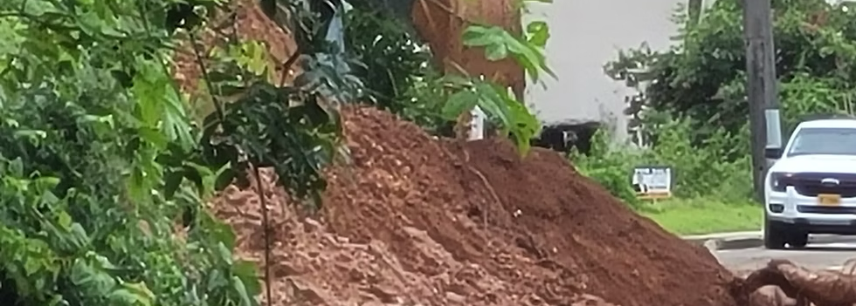
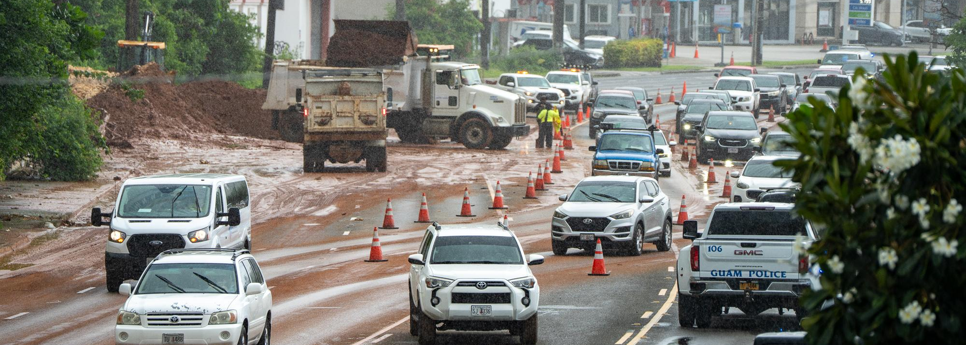

Slide 12
I. When God Delays our Desires
And they went through the region of Phrygia and Galatia, having been forbidden by the Holy Spirit to speak the word in Asia. And when they had come up to Mysia, they attempted to go into Bithynia, but the Spirit of Jesus did not allow them. So, passing by Mysia, they went down to Troas. And a vision appeared to Paul in the night: a man of Macedonia was standing there, urging him and saying, “Come over to Macedonia and help us.”
Acts 16:6-9

Slide 13
I. When God Delays our Desires
He may be directing us to NEW work spaces
He may be directing us to NEW faces
He may be directing us to NEW places

Slide 14
I. When God Delays our Desires
He may be directing us to NEW work spaces
He may be directing us to NEW faces
He may be directing us to NEW places
He may not be the one delaying us

Slide 15
I. When God Delays our Desires
because we wanted to come to you—I, Paul, again and again—but Satan hindered us.
1 Thess. 2:18

Slide 16
Romans 15:23
But now, since I no longer have any room for work in these regions, and since I have longed for many years to come to you,

Slide 17
II. When God Opens Doors our Direction
It may be that work is finished

Slide 18
Romans 15:23
But now, since I no longer have any room for work in these regions, and since I have longed for many years to come to you,

Slide 19
II. When God Opens Doors our Direction
It may be that work is finished
It may be our spirit leading us

Slide 20
Romans 15:24-25
I hope to see you in passing as I go to Spain, and to be helped on my journey there by you, once I have enjoyed your company for a while. At present, however, I am going to Jerusalem bringing aid to the saints.

Slide 21
Romans 15:26-27
For Macedonia and Achaia have been pleased to make some contribution for the poor among the saints at Jerusalem. For they were pleased to do it, and indeed they owe it to them. For if the Gentiles have come to share in their spiritual blessings, they ought also to be of service to them in material blessings.

Slide 22
Romans 15:28-29
When therefore I have completed this and have delivered to them what has been collected, I will leave for Spain by way of you. I know that when I come to you I will come in the fullness of the blessing of Christ.

Slide 23
III. When “Daring to Do” Starts a Journey
First set your priorities
a. “I hope to see you”
b. “When I have completed this”

Slide 24
III. When “Daring to Do” Starts a Journey
First set your priorities
a. “I hope to see you in passing”
(means Spain is priority visit)
b. “When I have completed this”
(means current work is priority job)

Slide 25
Romans 15:24-26
however, I am going to Jerusalem bringing aid to the saints. For Macedonia and Achaia have been pleased to make some contribution for the poor among the saints at Jerusalem.

Slide 26
III. When “Daring to Do” Starts a Journey
What is the job to complete?
Faithful Leadership of Macedonia & Achaia
* Shaping hands (pleased to make)

Slide 27
Romans 15:24-26
For they were pleased to do it, and indeed they owe it to them. For if the Gentiles have come to share in their spiritual blessings, they ought also to be of service to them in material blessings.

Slide 28
III. When “Daring to Do” Starts a Journey
What is the job to complete?
Faithful Leadership of Macedonia & Achaia
* Shaping hands (pleased to make)
*Shaping hearts (pleased to do it)

Slide 29
Romans 15:24-25
I hope to see you in passing as I go to Spain, and to be helped on my journey there by you, once I have enjoyed your company for a while. At present, however, I am going to Jerusalem bringing aid to the saints.

Slide 30
III. When “Daring to Do” Starts a Journey
First set your priorities
Fit the dream in (in passing)
*On the way to Spain
a. Utilizing resources (helped by you)
b. Utilizing rest/fellowship (enjoyed company)
c. Recharging from journey (refreshed)

Slide 31
Romans 15:29
I know that when I come to you I will come in the fullness of the blessing of Christ.

Slide 32
III. When “Daring to Do” Starts a Journey
First set your priorities
Fit the dream in (in passing)
a. It Fits in schedule
b. It Fits in confidence

Slide 33
Romans 15:30
I appeal to you, brothers, by our Lord Jesus Christ and by the love of the Spirit, to strive together with me in your prayers to God on my behalf,

Slide 34
III. When “Daring to Do” Starts a Journey
First set your priorities
Fit the dream in
Find others to support the dream

Slide 35
Romans 15:30
that I may be delivered from the unbelievers in Judea, and that my service for Jerusalem may be acceptable to the saints, so that by God's will I may come to you with joy and be refreshed in your company. May the God of peace be with you all. Amen.

