Slide 1



Slide 3
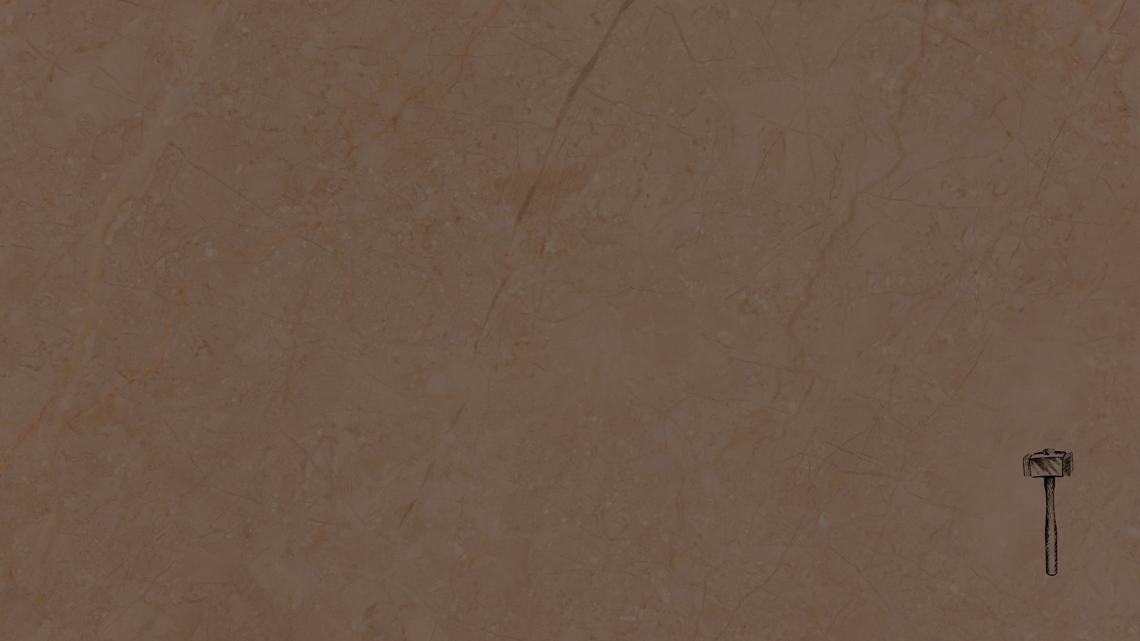
Background & Context
Ezra & Nehemiah tell the two parts of a macro story
Jews return to Jerusalem ~537 BC (Ezra 1:11); altar rebuilt 537 (3:1-2); temple construction finished 516 (6:15); Ezra arrives in Jerusalem 458 (7:6-9)
13 years later… Nehemiah’s story (Ne 2:1)
Ezra’s work overlaps with Nehemiah’s (Ne 8). These books are records of specific people and circumstances in time AND we have joined God’s covenant people, and the lessons are fit for us today (Ezra 6:20-21).

Slide 4
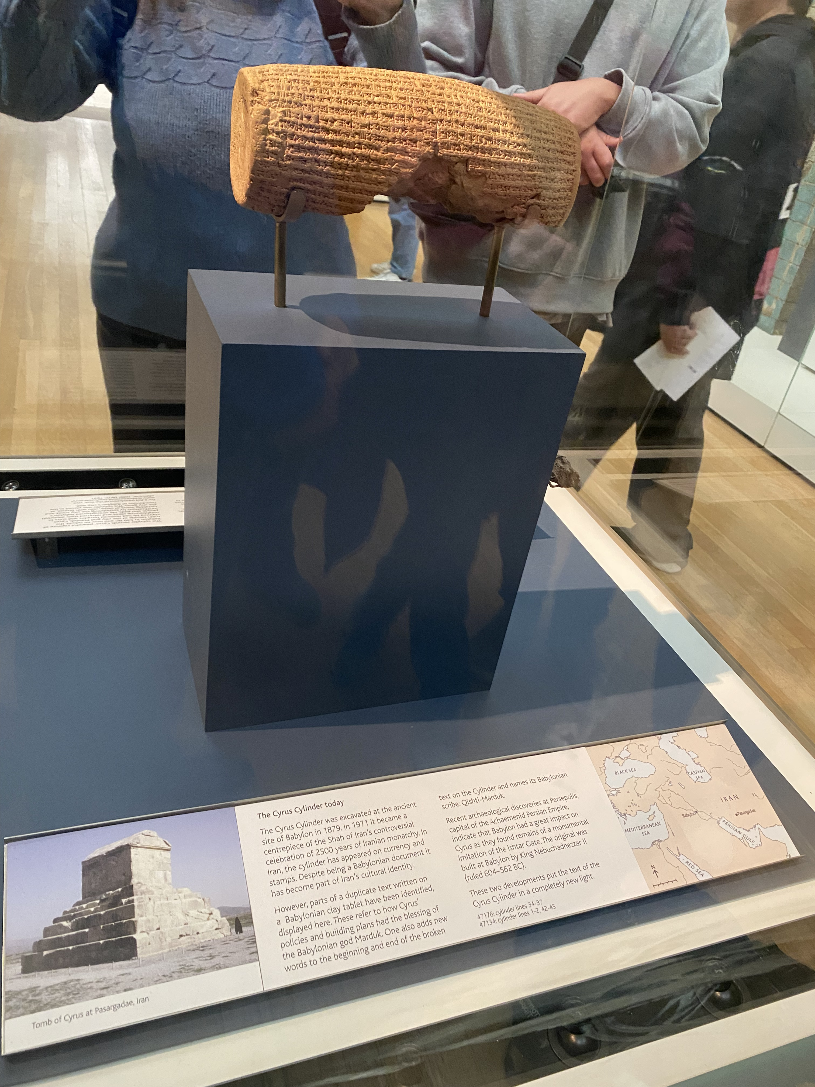
Confidence in the Bible
2 Chron 36:17-20; Ezra 1:1-4, 11
That’s crazy right? The king of a victorious nation just deciding to release all his country’s enemies taken captive and not just that, but send them back to their own land to rebuild and get stronger? And decrees the people are to help them in this?? Because his enemies’ deity told him to do it???
Cyrus Cylinder discovered 1879. And guess what if confirmed?

Slide 5
Theme
In the whole story of the rebuilding (Ezra & Nehemiah), we see lessons on hope, assurance, a call to renewed zealous devotion to the Lord.
Nehemiah specifically: Restoration work
  Restore structural integrity. Restore the zeal of the people. Restore the commitment to the covenant.
  Restoration work during hardship, surrounded by ungodly values

Slide 6
How it shows the Biblical narrative
Creation, fall, redemption, restoration.
Jesus restores our lost fellowship with, and access to, God. Sanctification is a restorative event & process of a life set apart for God. We look forward to the future perfect restoration of all things.
Matthew 27:50-51 → Hebrews 10:19-22
1 Peter 5:10
Acts 3:19-21

Slide 7
Nehemiah 1:1-4
How do we react to problems?
Are we grieved by problems (even those that aren’t immediately our own)?
Is our instinct to bring problems to the Lord in prayer?
  2 Chronicles 7:14
  Acts 4:23-31; 12:1-5, 12; 16:19-25

Slide 8
Nehemiah 1:5-11. Do your prayers:
Begin with praise? (v5)
Have humble reflection & confession? (vv6-7)
Have hope and assurance in God’s character and promises? (vv8-10)
Recognize (and submit/appeal to) God’s sovereignty? (v11)
Daniel 8:27; 9:2-13, 18-19

Slide 9
This Week Let’s All
Read: Ezra 1-10
Pray: As led by the Holy Spirit and the reading
Remember: Habakkuk 3:17-19
Reflect: Pay extra attention to your prayers this week. Is prayer your immediate instinct? Do you have a balanced prayer life?

