Slide 1


ABRAHAM'S FAITH
FRIEND OF GOD

Slide 2
Covenant of Faith
Genesis 15:7-21

Slide 3


Slide 4
ABRAHAM'S FAITH
And he believed the Lord, and he counted it to him as righteousness.
Genesis 15:6

Slide 5
ABRAHAM'S FAITH
And he said to him, “I am the Lord who brought you out from Ur of the Chaldeans to give you this land to possess.”
Genesis 15:7

Slide 6
ABRAHAM'S FAITH
Ancient Covenants of Promise
The Suzerain Vassel Treaty

Slide 7
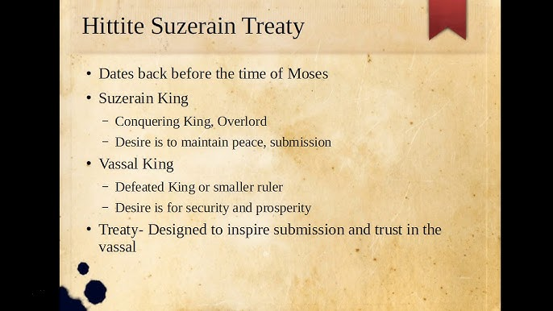

Slide 8
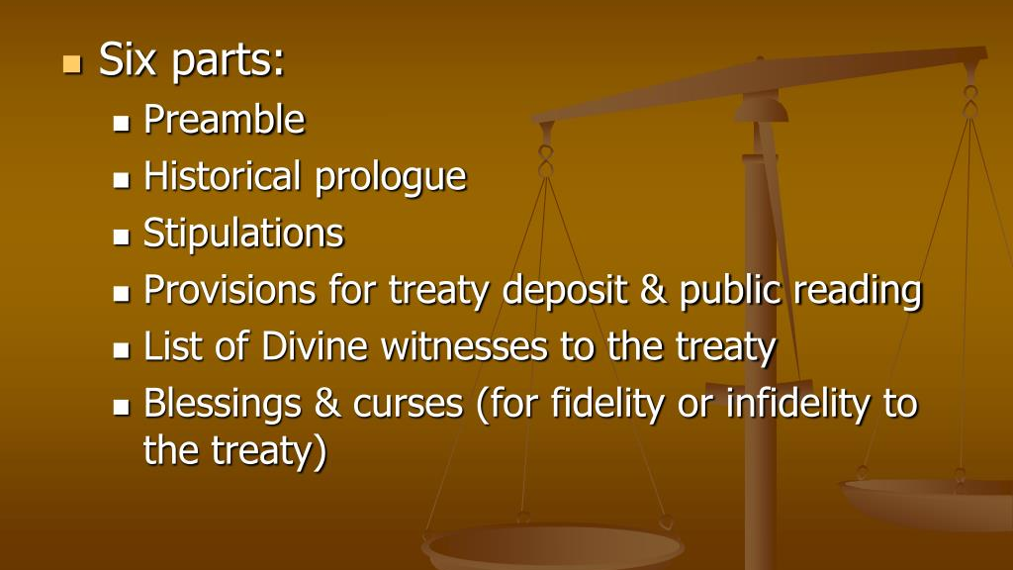

Slide 9
ABRAHAM'S FAITH
Ancient Covenants of Promise
Identify the parties involved (Historical Prologue)

Slide 10
ABRAHAM'S FAITH
And he said to him, “I am the Lord who brought you out from Ur of the Chaldeans to give you this land to possess.”
Genesis 15:7

Slide 11
ABRAHAM'S FAITH
Ancient Covenants of Promise
Identify the parties involved
*One party is a provider
*The other party is a recipient

Slide 12
ABRAHAM'S FAITH
Ancient Covenants of Promise
Identify the parties involved
Detail expectations and assurances (Stipulations)

Slide 13
ABRAHAM'S FAITH
But he said, “O Lord God, how am I to know that I shall possess it?”
Genesis 15:8

Slide 15
ABRAHAM'S FAITH
Ancient Covenants of Promise
Identify the parties involved
Detail expectations and assurances
*He doesn’t understand God’s timeline

Slide 16
ABRAHAM'S FAITH
Ancient Covenants of Promise
Identify the parties involved
Detail expectations and assurances
*He doesn’t understand God’s timeline
*He needs help with his unbelief

Slide 17
ABRAHAM'S FAITH
Mark 9:24

Slide 18
ABRAHAM'S FAITH
He said to him, “Bring me a heifer three years old, a female goat three years old, a ram three years old, a turtledove, and a young pigeon.”
Genesis 15:9-11

Slide 19
ABRAHAM'S FAITH
And he brought him all these, cut them in half, and laid each half over against the other. But he did not cut the birds in half. And when birds of prey came down on the carcasses, Abram drove them away.
Genesis 15:9-11

Slide 20
ABRAHAM'S FAITH
Ancient Covenants of Promise
Identify the parties involved
Detail expectations and assurances
The Process of preparation

Slide 21
ABRAHAM'S FAITH
As the sun was going down, a deep sleep fell on Abram. And behold, dreadful and great darkness fell upon him.
Genesis 15:12

Slide 22
ABRAHAM'S FAITH
II. The Ceremony Goes Off Script
Surprise Twist #1—Half the party side-lined

Slide 23
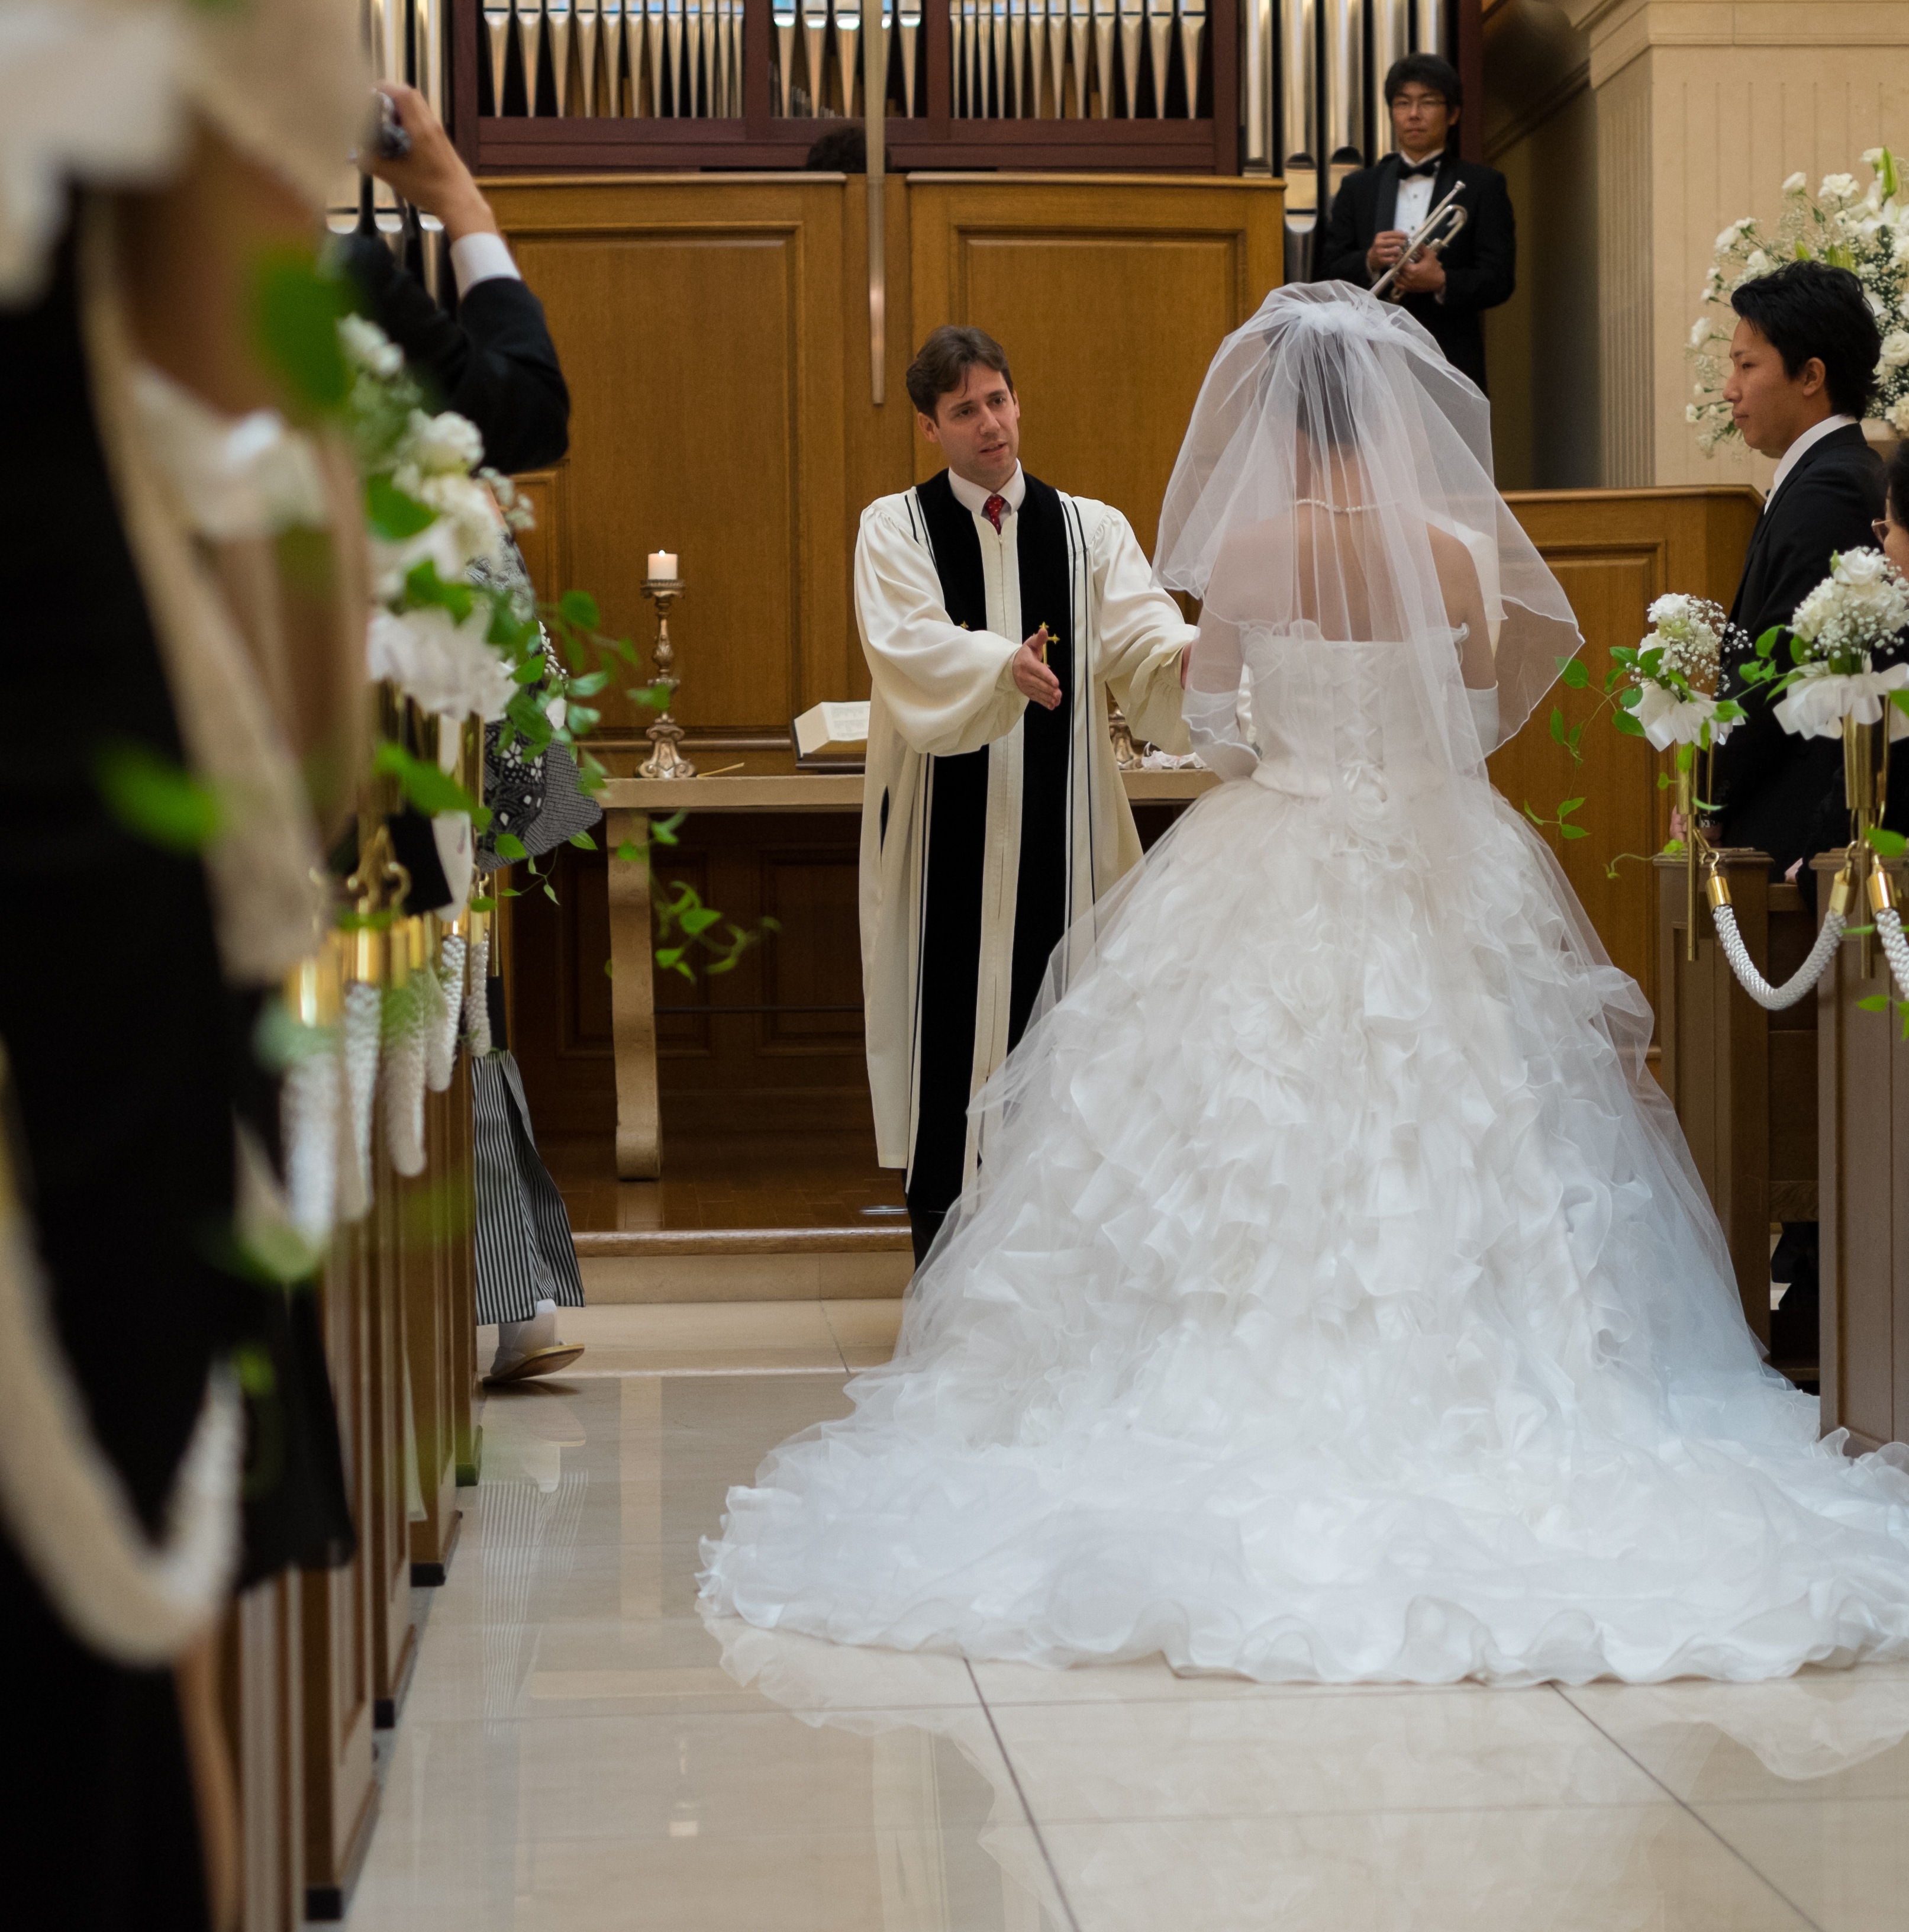
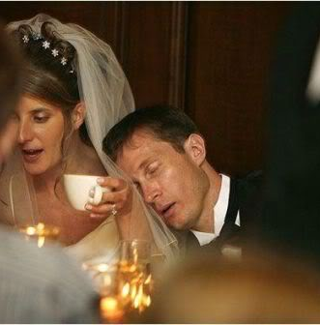

Slide 24
ABRAHAM'S FAITH
II. The Ceremony Goes Off Script
Surprise Twist #1—Half the party side-lined
Surprise Twist #2—Answering questions not asked
how am I to know

Slide 25
ABRAHAM'S FAITH
Then the Lord said to Abram, “Know for certain that your offspring will be sojourners in a land that is not theirs and will be servants there, and they will be afflicted for four hundred years.
Genesis 15:13-16

Slide 26
ABRAHAM'S FAITH
But I will bring judgment on the nation that they serve, and afterward they shall come out with great possessions.
Genesis 15:13-16

Slide 27
ABRAHAM'S FAITH
As for you, you shall go to your fathers in peace; you shall be buried in a good old age. And they shall come back here in the fourth generation, for the iniquity of the Amorites is not yet complete.”
Genesis 15:13-16

Slide 28
ABRAHAM'S FAITH
II. The Ceremony Goes Off Script
Answering questions not asked:
1.
2.
3.
4.

Slide 29
ABRAHAM'S FAITH
III. The Pronouncement of Promise
On that day

Slide 30
ABRAHAM'S FAITH
III. The Pronouncement of Promise
Presenting: The party responsible

Slide 31
ABRAHAM'S FAITH
When the sun had gone down and it was dark, behold, a smoking fire pot and a flaming torch passed between these pieces. On that day the Lord made a covenant with Abram, saying, “To your offspring I give this land
Genesis 15:17-18

Slide 32
ABRAHAM'S FAITH
III. The Pronouncement of Promise
Presenting: The party responsible
Presenting: The parameters of possession

Slide 33
ABRAHAM'S FAITH
“To your offspring I give[c] this land, from the river of Egypt to the great river, the river Euphrates, the land of the Kenites, the Kenizzites, the Kadmonites, the Hittites, the Perizzites, the Rephaim, the Amorites, the Canaanites, the Girgashites and the Jebusites.”
Genesis 15:19-21

Slide 34
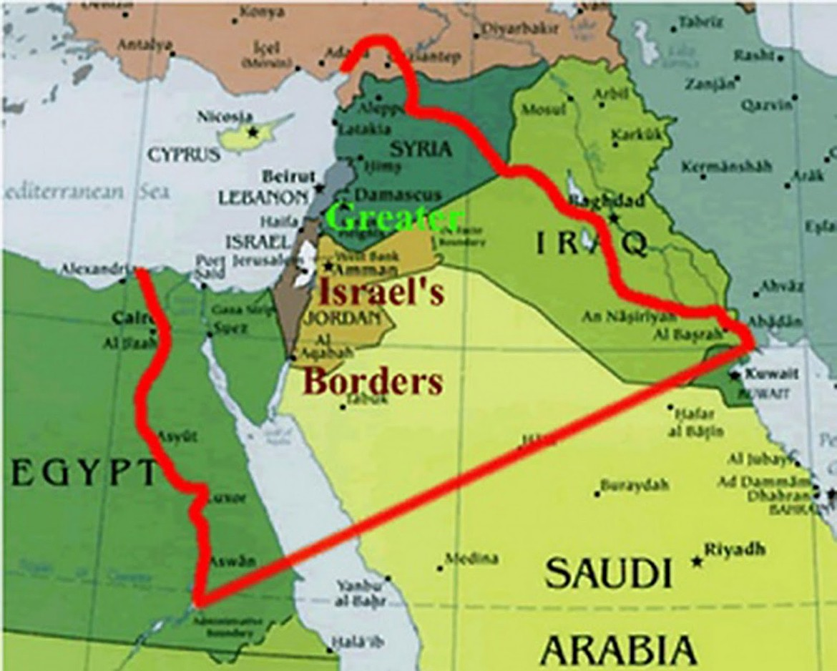

Slide 35
Called Into Faith
Faith builds over a lifetime, but is birthed in a moment.

