Slide 1
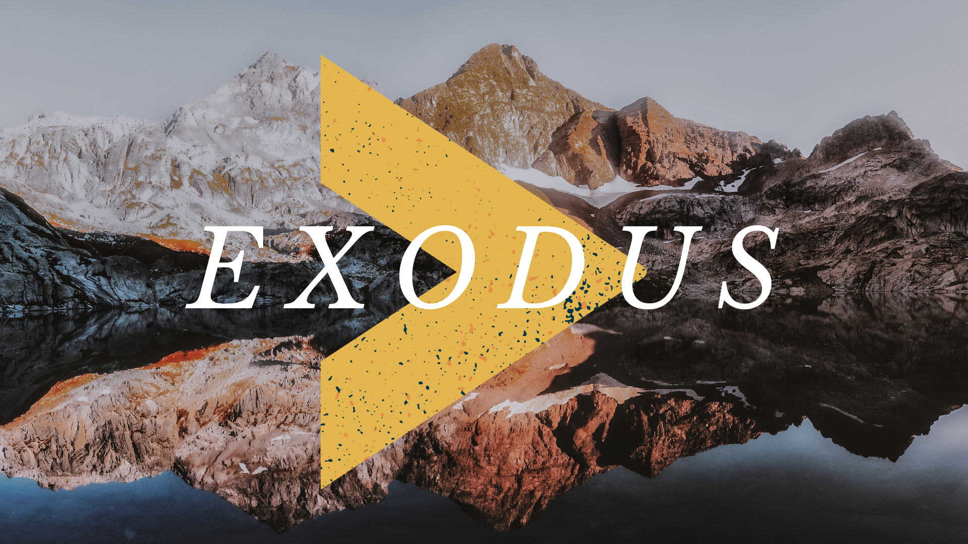

Slide 2
Exodus 7 - 11
Remember the theme: God is greater than ____
Pg 51 of the seat Bibles
“The grass withers, the flower fades,
but the word of our God will stand forever.”
Isaiah 40:8

Slide 3
A lie imitates but ultimately fails
7:8-13; 7:20-22; 8:6-7; 8:16-19
Do not be surprised by that tactic
John 8:43-44
2 Corinthians 11:3, 12-15
Magicians, fortune tellers, healers in the NT
And do not be dismayed! Truth wins out!
Luke 8:17
John 8:31-32

Slide 4
False gods ultimately fail
Exodus 12:12
Exodus 15:11
Exodus 18:8, 10-11
Numbers 33:3-4

Slide 5
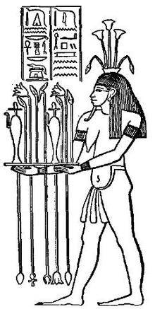
Disproving Hapi
god of the annual flooding of the Nile
one of the most important and powerful Egyptian gods for the life the river provided the region
“Lord of the Fish, Birds, and Marshes”
Exodus 7:17-21

Slide 6
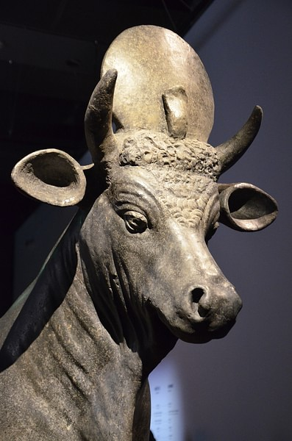
Disproving Apis
Bull considered sacred and worshipped by the Egyptians
Exodus 9:1-6

Slide 7
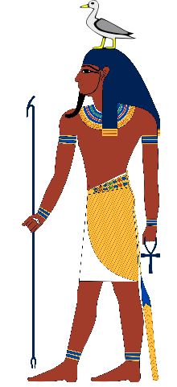
Disproving Geb
god of the earth, who Egyptians believed allowed crops to grow
Exodus 9:22-26, 29
Exodus 10:12-15
(He was also considered the father of snakes, Aaron’s staff/snake ate the snakes of the Egyptian magicians)

Slide 8
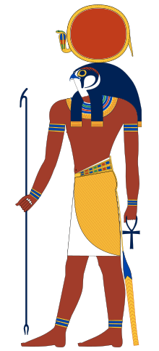
Disproving Ra/Re
one of the most important gods
Egyptians believed Ra carried the sun across the sky & lit the day
Exodus 10:21-23

Slide 9
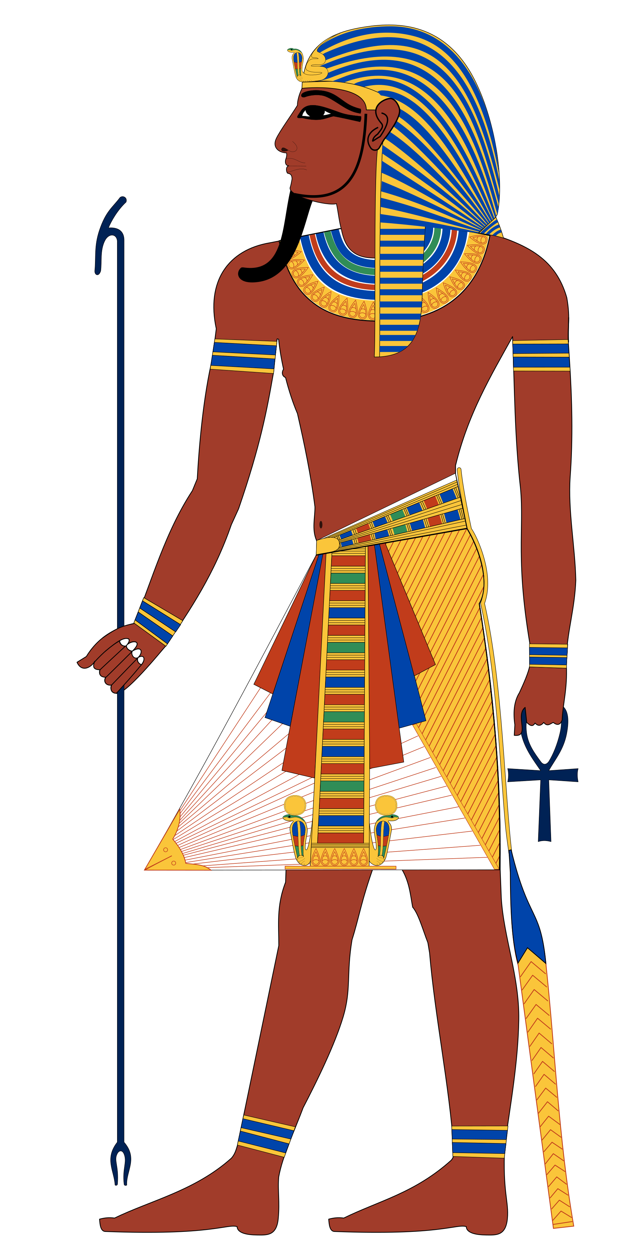
Systematically dismantling idolatry
And ultimately, the Egyptians viewed Pharaoh as a god in his power.
Exodus 11:4-7
Exodus 12:29-30

Slide 10
Who weighs the heart?
Osiris was the chief god of the afterlife; the crucial moment in Egyptian afterlife was the Weighing of the Heart ceremony
1 Samuel 16:7
1 Kings 8:39
Ps 44:21
Proverbs 21:2
Jeremiah 17:10

Slide 11
God alone is God.
Hebrews lived east of Egypt in Goshen. Many cultures in OT time believed in deities bound to certain places and land
See Naaman in 2 Kings 5:17
God exercises His power in Egypt, “not” His land
1 Samuel 5:1-7
Isaiah 40:18-26
Isaiah 46:1-10
Jonah 1:4-6, 9, 13-16

Slide 12
This Week Let’s All
Read: 1 Kings 18
Pray: As led by the reading
Remember: Exodus 4:11-12
Apply: Praise God for being true. Rejoice in being known by the one God.

