Slide 2
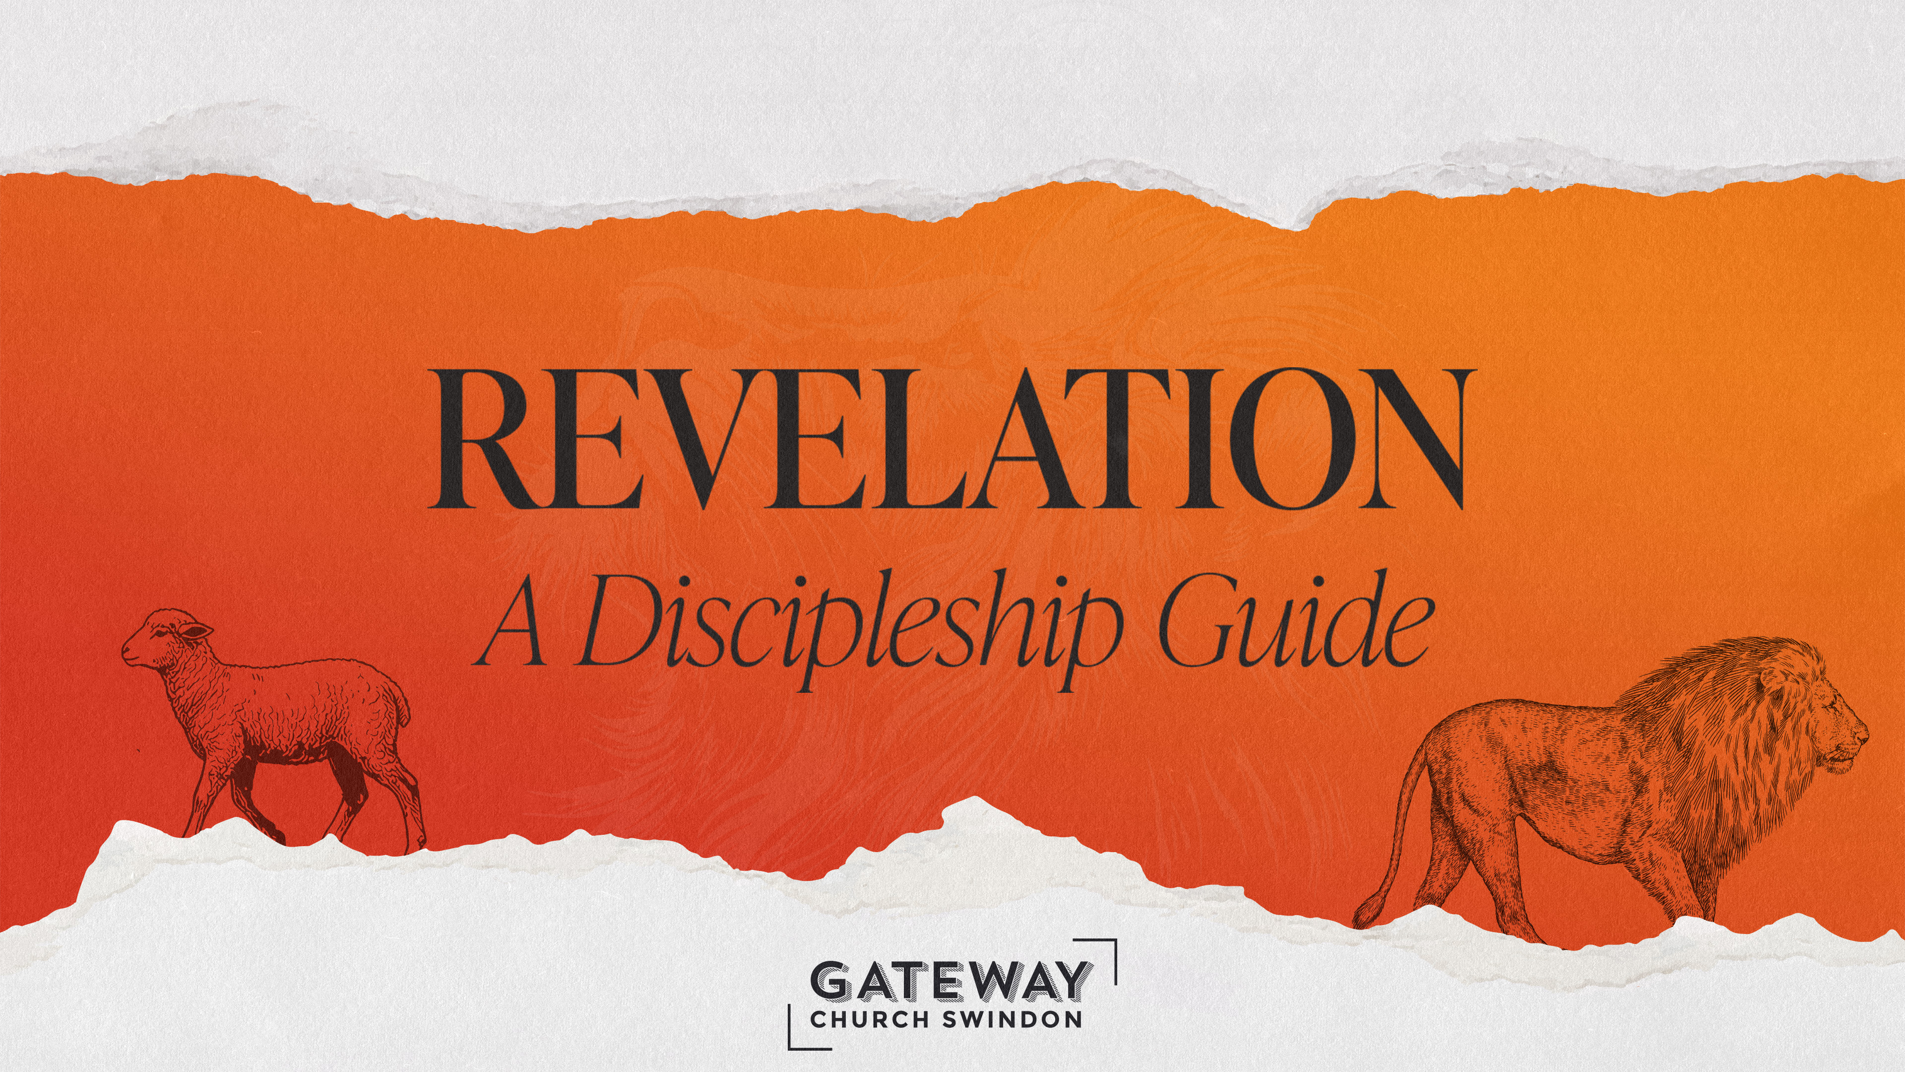

Slide 3
Garden of Eden
Heaven (God’s Space) and Earth (Human’s Space) united
Adapted from Bible Project ‘Heaven and Earth’ video

Slide 4
Heaven
Earth
SIN & REBELLION

Slide 5
Heaven
Earth

Slide 6
New Heavens and New Earth = Full and Final re-uniting of heaven and earth for eternity

Slide 7
Babylon
City of Man
Represents empires and societies (‘the world’) that are anti-God
Built on greed, exploitation, idolatry and oppression
Seeks glory for itself
Now but temporary (Babylon falls!)
Marked by death and destruction
New Jerusalem
City of God
Represents the people of God across the world (the global church)
Built on love, peace, generosity, healing and joy
Seeks glory for one true God
Now and eternal
Marked by eternal life

Slide 8
21 Then I saw a new heaven and a new earth, for the first heaven and the first earth had passed away, and the sea was no more. ² And I saw the holy city, new Jerusalem, coming down out of heaven from God, prepared as a bride adorned for her husband.
- Revelation 21:1-22:5 (ESVUK)
Notes:
Text Gil Sans MT 40
Ref Gil Sans MT 24

Slide 9
³ And I heard a loud voice from the throne saying, “Behold, the dwelling place of God is with man. He will dwell with them, and they will be his people, and God himself will be with them as their God. ⁴ He will wipe away every tear from their eyes, and death shall be no more, neither shall there be mourning, nor crying, nor pain any more, for the former things have passed away.”
- Revelation 21:1-22:5 (ESVUK)
Notes:
Text Gil Sans MT 40
Ref Gil Sans MT 24

Slide 10
⁵ And he who was seated on the throne said, “Behold, I am making all things new.” Also he said, “Write this down, for these words are trustworthy and true.”
- Revelation 21:1-22:5 (ESVUK)
Notes:
Text Gil Sans MT 40
Ref Gil Sans MT 24

Slide 11
⁶ And he said to me, “It is done! I am the Alpha and the Omega, the beginning and the end. To the thirsty I will give from the spring of the water of life without payment. ⁷ The one who conquers will have this heritage, and I will be his God and he will be my son.
- Revelation 21:1-22:5 (ESVUK)
Notes:
Text Gil Sans MT 40
Ref Gil Sans MT 24

Slide 12
⁸ But as for the cowardly, the faithless, the detestable, as for murderers, the sexually immoral, sorcerers, idolaters, and all liars, their portion will be in the lake that burns with fire and sulphur, which is the second death.”
- Revelation 21:1-22:5 (ESVUK)
Notes:
Text Gil Sans MT 40
Ref Gil Sans MT 24

Slide 13
⁹ Then came one of the seven angels who had the seven bowls full of the seven last plagues and spoke to me, saying, “Come, I will show you the Bride, the wife of the Lamb.” ¹⁰ And he carried me away in the Spirit to a great, high mountain, and showed me the holy city Jerusalem coming down out of heaven from God, ¹¹ having the glory of God, its radiance like a most rare jewel, like a jasper, clear as crystal.
- Revelation 21:1-22:5 (ESVUK)
Notes:
Text Gil Sans MT 40
Ref Gil Sans MT 24

Slide 14
¹² It had a great, high wall, with twelve gates, and at the gates twelve angels, and on the gates the names of the twelve tribes of the sons of Israel were inscribed— ¹³ on the east three gates, on the north three gates, on the south three gates, and on the west three gates. ¹⁴ And the wall of the city had twelve foundations, and on them were the twelve names of the twelve apostles of the Lamb.
- Revelation 21:1-22:5 (ESVUK)
Notes:
Text Gil Sans MT 40
Ref Gil Sans MT 24

Slide 15
¹⁵ And the one who spoke with me had a measuring rod of gold to measure the city and its gates and walls. ¹⁶ The city lies foursquare, its length the same as its width. And he measured the city with his rod, 12,000 stadia. Its length and width and height are equal. ¹⁷ He also measured its wall, 144 cubits by human measurement, which is also an angel's measurement.
- Revelation 21:1-22:5 (ESVUK)
Notes:
Text Gil Sans MT 40
Ref Gil Sans MT 24

Slide 16
¹⁸ The wall was built of jasper, while the city was pure gold, clear as glass. ¹⁹ The foundations of the wall of the city were adorned with every kind of jewel. The first was jasper, the second sapphire, the third agate, the fourth emerald, ²⁰ the fifth onyx, the sixth carnelian, the seventh chrysolite, the eighth beryl, the ninth topaz, the tenth chrysoprase, the eleventh jacinth, the twelfth amethyst.
- Revelation 21:1-22:5 (ESVUK)
Notes:
Text Gil Sans MT 40
Ref Gil Sans MT 24

Slide 17
²¹ And the twelve gates were twelve pearls, each of the gates made of a single pearl, and the street of the city was pure gold, transparent as glass.
²² And I saw no temple in the city, for its temple is the Lord God the Almighty and the Lamb. ²³ And the city has no need of sun or moon to shine on it, for the glory of God gives it light, and its lamp is the Lamb.
- Revelation 21:1-22:5 (ESVUK)
Notes:
Text Gil Sans MT 40
Ref Gil Sans MT 24

Slide 18
²⁴ By its light will the nations walk, and the kings of the earth will bring their glory into it, ²⁵ and its gates will never be shut by day—and there will be no night there. ²⁶ They will bring into it the glory and the honour of the nations. ²⁷ But nothing unclean will ever enter it, nor anyone who does what is detestable or false, but only those who are written in the Lamb's book of life.
- Revelation 21:1-22:5 (ESVUK)
Notes:
Text Gil Sans MT 40
Ref Gil Sans MT 24

Slide 19
22 Then the angel showed me the river of the water of life, bright as crystal, flowing from the throne of God and of the Lamb ² through the middle of the street of the city; also, on either side of the river, the tree of life with its twelve kinds of fruit, yielding its fruit each month. The leaves of the tree were for the healing of the nations.
- Revelation 21:1-22:5 (ESVUK)
Notes:
Text Gil Sans MT 40
Ref Gil Sans MT 24

Slide 20
³ No longer will there be anything accursed, but the throne of God and of the Lamb will be in it, and his servants will worship him. ⁴ They will see his face, and his name will be on their foreheads. ⁵ And night will be no more. They will need no light of lamp or sun, for the Lord God will be their light, and they will reign for ever and ever.
- Revelation 21:1-22:5 (ESVUK)
Notes:
Text Gil Sans MT 40
Ref Gil Sans MT 24

Slide 22
In the new creation…
We will be with God
“The dwelling place of God will be with man. He will dwell with them, and they will be his people, and God himself will be with them as their God” (Rev 21:3)

Slide 23
In the new creation…
All things will be made new
“And he who was seated on the throne said, ‘Behold, I am making all things new’. Also he said, ‘write this down, for these words are trustworthy and true.’ And he said to me, ‘It is done! I am the Alpha and Omega, the beginning and the end.” (Rev 21:5-6a)

Slide 24
In the new creation…
We will be fully and finally satisfied
“To the thirsty I will give from the spring of the water of life without payment”. (Rev 21:6b)

Slide 25
In the new creation…
We will reign and rule with Jesus
“The one who conquers will have this heritage [inheritance], and I will be his God and he will be my son”. (Rev 21:7)

Slide 26
And there will be…
No sea (Rev 21:1)
No sadness, mourning, crying or pain (Rev 21:4)
No death (Rev 21:4)
No sin or evil (Rev 21:8)

Slide 27
“I have come home at last! This is my real country! I belong here. This is the land I have been looking for all my life, though I never knew it till now...Come further up, come further in!
“And as He [Aslan] spoke, He no longer looked to them like a lion; but the things that began to happen after that were so great and beautiful that I cannot write them. And for us this the end of all the stories, and we can most truly say that they all lived happily ever after. But for them it was only the beginning of the real story. All their life in this world and all their adventures in Narnia had only been the cover and the title page: now at last they were beginning Chapter One of the Great Story which no one on earth has read: which goes on for ever: in which every chapter is better than the one before.”
- CS Lewis, The Last Battle

Slide 28
The church is and will be the place of…
God’s Glory and Presence
“having the glory of God, its radiance like a most rare jewel”
”The city lies foursquare, its length the same as its width. And he measured the city with his rode, 12,000 stadia. Its length and width and height are equal”
“And I saw no Temple in the city, for its Temple is the Lord God Almighty and the Lamb”

Slide 29
The church is and will be the place of…
Healing and Life to the World
“Then the angel showed me the river of the water of life, bright as crystal, flowing from the throne of God and of the Lamb”
“On either side of the river, the tree of life…the leaves of the tree were for the healing of the nations”
“By its light the nation walk, and the kings of the earth will b ring their glory into it”

Slide 30
The church is and will be the place of…
Purity and Holiness
”Nothing unclean will ever enter it, nor anyone who does what is detestable or false, but only those who are written in the Lamb’s book of life”
“No longer will there be anything accursed, but the throne of God and the Lamb will be in it, and his servants will worship him”

Slide 33
¹¹ I saw heaven standing open and there before me was a white horse, whose rider is called Faithful and True. With justice he judges and wages war. ¹² His eyes are like blazing fire, and on his head are many crowns. He has a name written on him that no one knows but he himself. ¹³ He is dressed in a robe dipped in blood, and his name is the Word of God.
- Revelation 19:11-15a (NIVUK)
Notes:
Text Gil Sans MT 40
Ref Gil Sans MT 24

