Slide 1
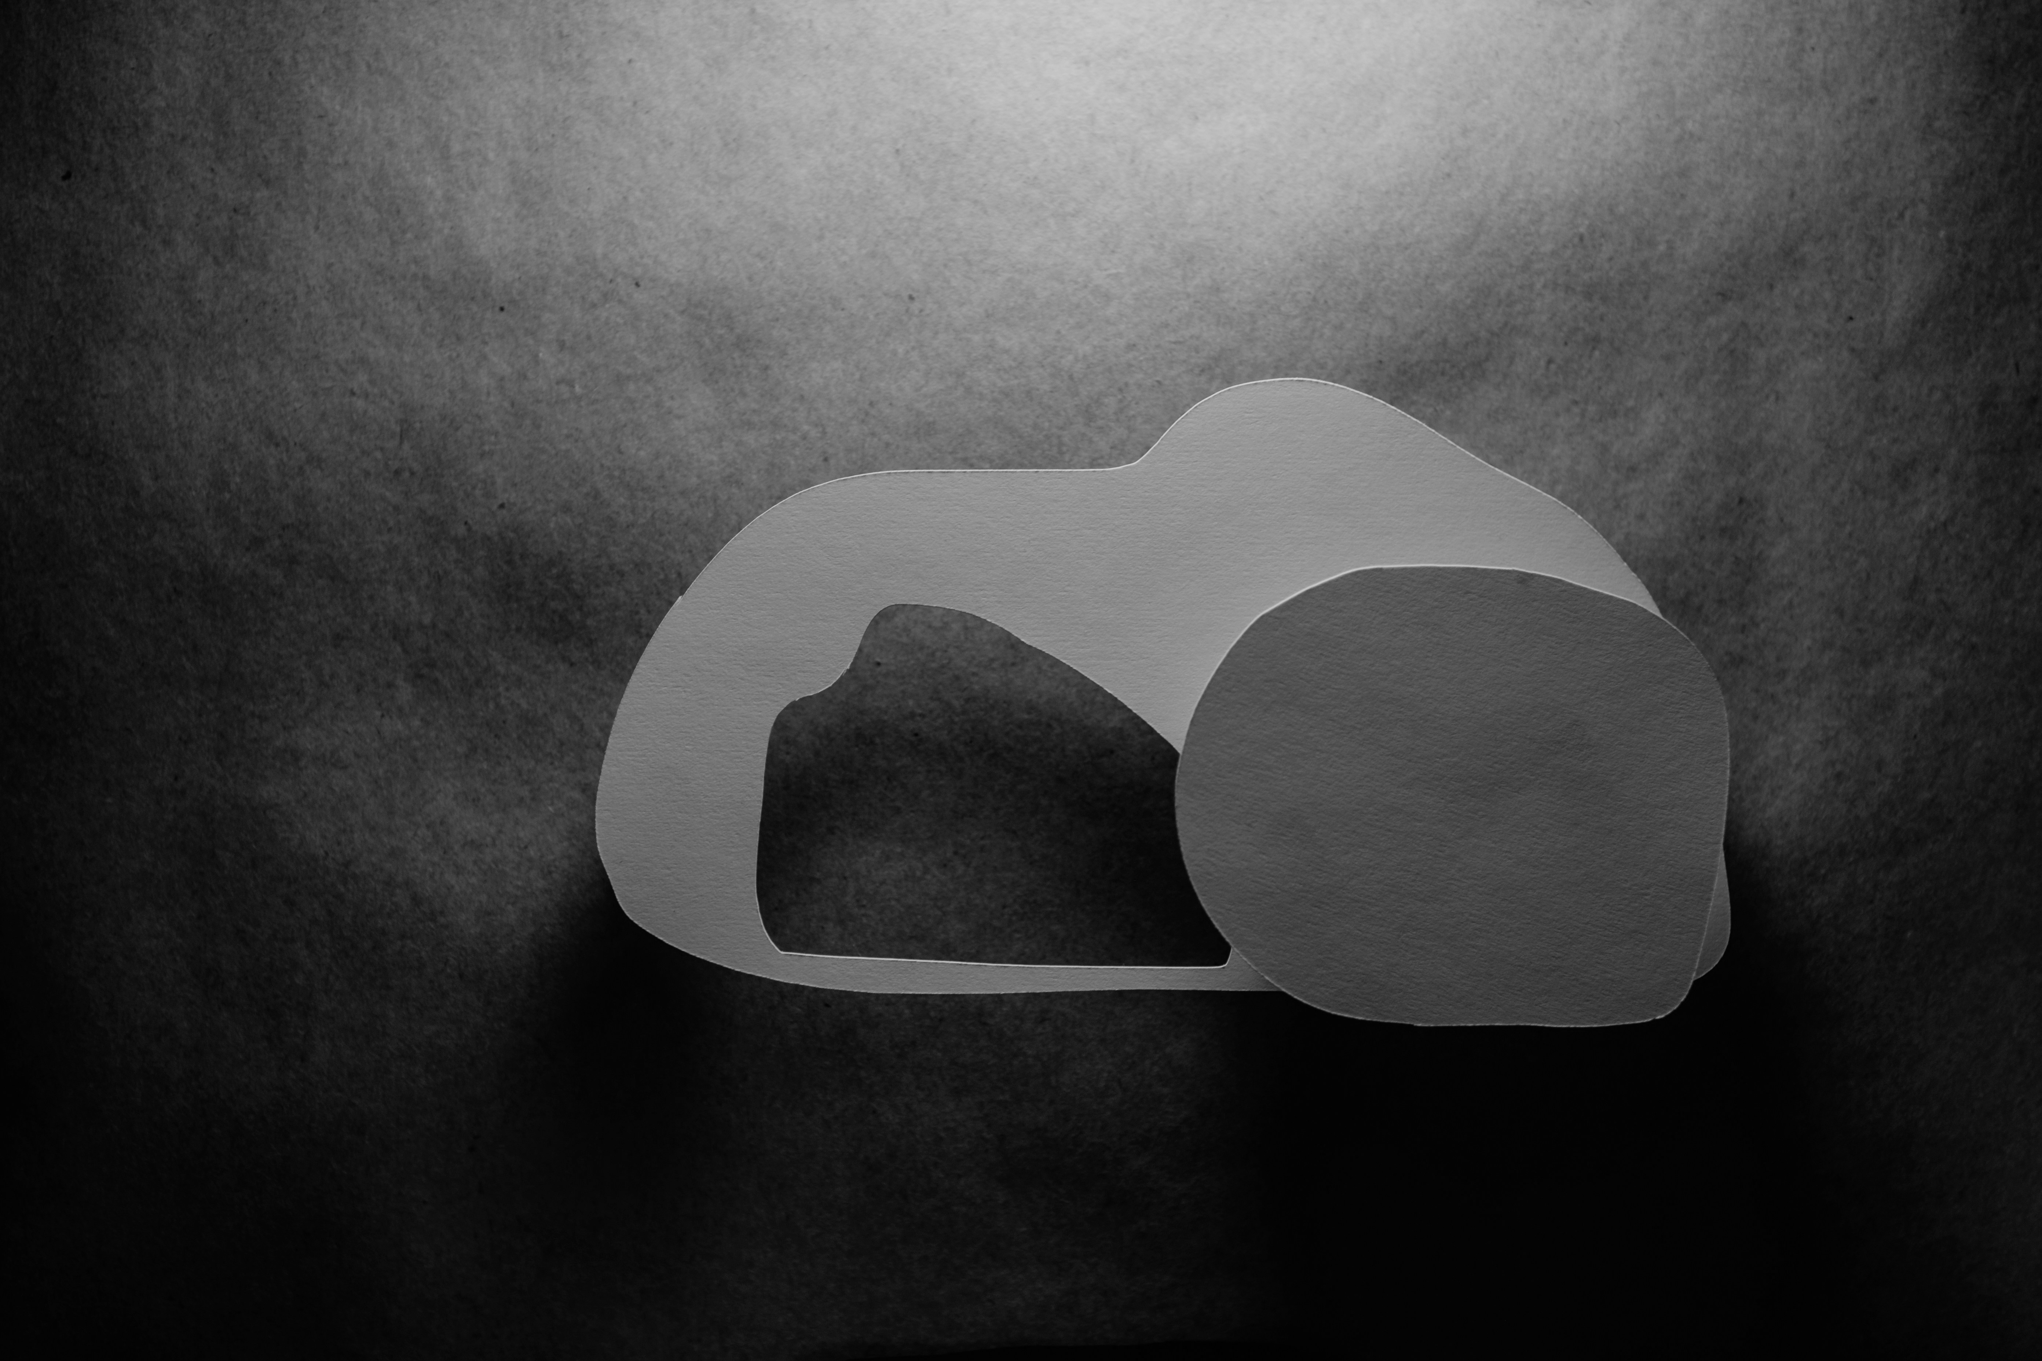
Victory in Jesus!
1 Corinthians 15:57

Slide 2
Big Idea
Because the grave is empty, our faith is not. Because death is defeated, we are not.

Slide 3
1. God Provides
Because of the cross, God gives us what we need (mercy), not what we deserve (justice).

Slide 4
2. Death Defeated
The One who defeated death simply won’t be defeated by anything in your life.

Slide 5
3. Jesus Saves
It's not a strong faith that saves but a strong Christ.

