Slide 1
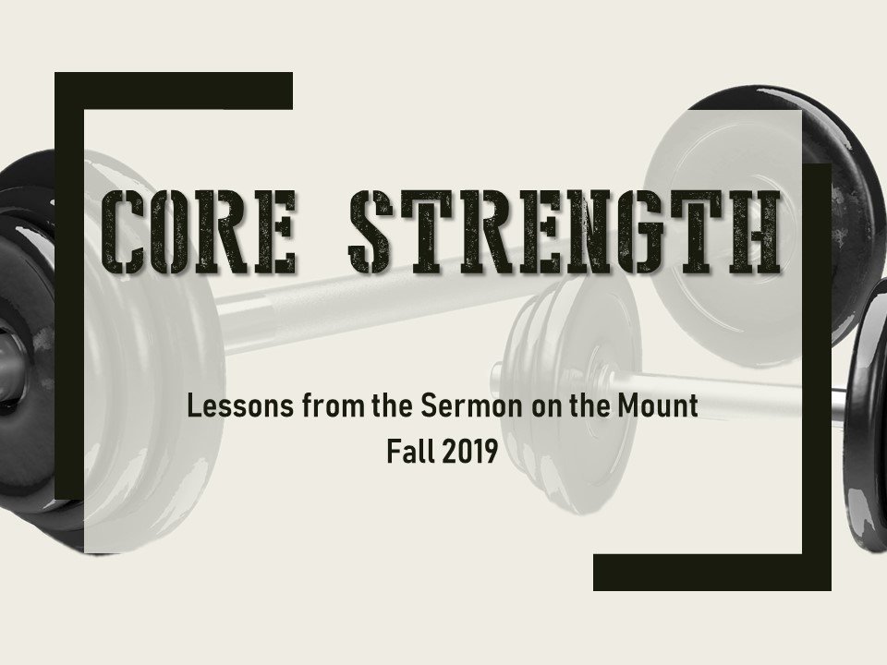

Core strength
Lessons from the Sermon on the Mount
Fall 2019

Slide 2
Core Strength Begins with Jesus
Pastor Greg Couser
Emmanuel Baptist Church

Slide 3
²⁸ “Come to me, all you who are weary and burdened, and I will give you rest. ²⁹ Take my yoke upon you and learn from me, for I am gentle and humble in heart, and you will find rest for your souls. ³⁰ For my yoke is easy and my burden is light.”
Jesus (Matthew 11)

Slide 4
Core Strength
The Character and Call Approved by God
Pastor Greg Couser
Emmanuel Baptist Church

Slide 5

The Character Approved by God
Matt 5:3-12

Slide 6
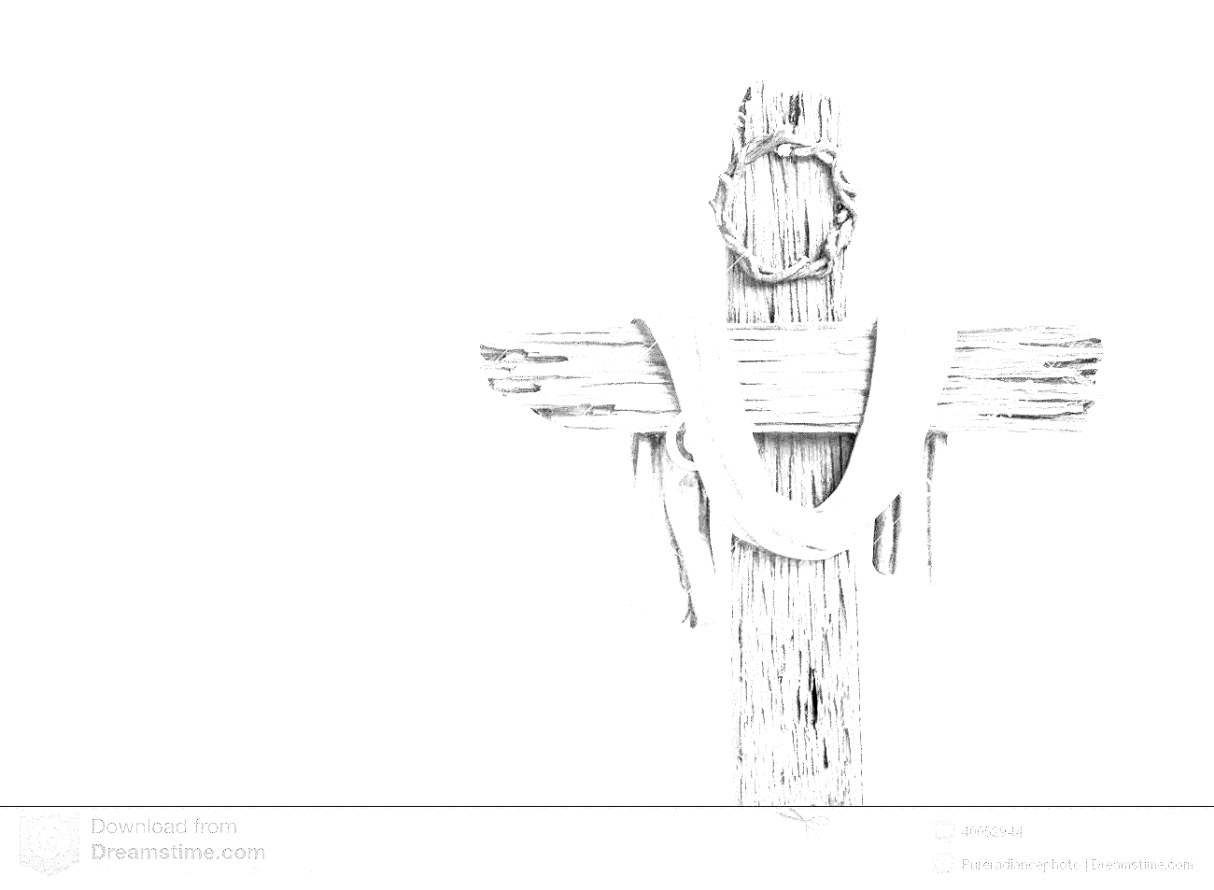

Kingdom Consummated at Christ’s Return
Kingdom Initiated at Christ’s coming
Already
Not yet
Kingdom fully Realized: “the Resurrection”
Present Evil Age: Last Days
Jesus: “theirs is the kingdom… & they will…”

Slide 7










Slide 8

The Call Approved by God
Matt 5:13-16

Slide 9
Are we looking to God for help and guidance and not to ourselves or anyone else?
Are we broken at our own sin and the sin in the lives of those around us?
Are we trusting God to do things his way even if his way is hard or its not getting the results we want when we want them?
Are we passionately pursuing God’s standards for our lives?

Slide 10
Are we showing pity on those caught in sin, a pity that combines compassion and action?
Are we longing for a heart united to fear God so that every area of our life is submitted to his rule?
Are we working to reconcile people to God and one another?
Are we expecting persecution and willing to face mockery and abuse for the sake of Jesus?

Slide 11
²⁸ “Come to me, all you who are weary and burdened, and I will give you rest. ²⁹ Take my yoke upon you and learn from me, for I am gentle and humble in heart, and you will find rest for your souls. ³⁰ For my yoke is easy and my burden is light.”
Jesus (Matthew 11)

