Slide 1
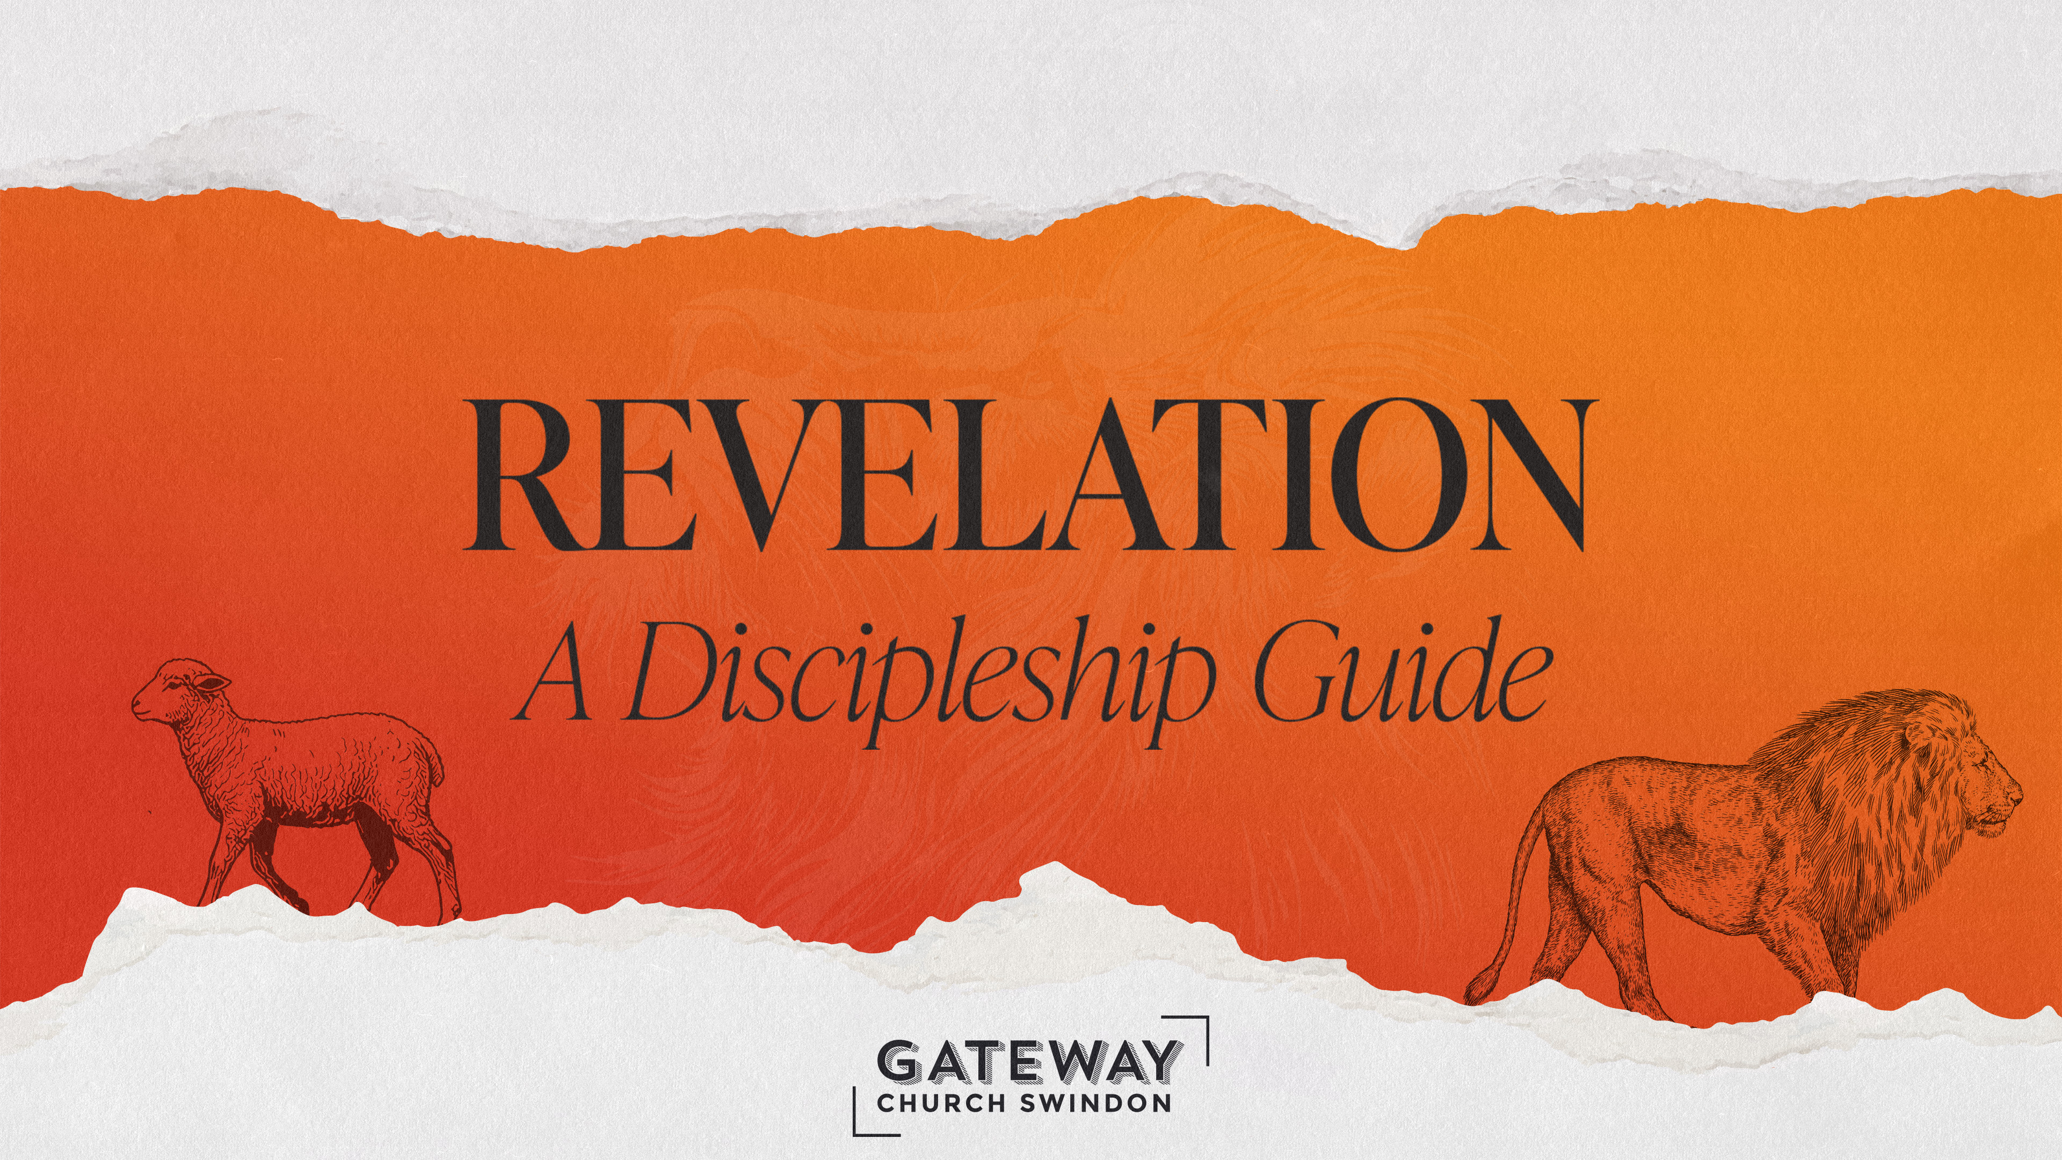

Slide 2
^{4:8} Each of the four living creatures had six wings and was covered with eyes all round, even under its wings. Day and night they never stop saying:
  ‘“Holy, holy, holy
  is the Lord God Almighty,
  who was, and is, and is to come.’”
- Revelation 4:8-11, NIVUK

Slide 3
⁹ Whenever the living creatures give glory, honour and thanks to him who sits on the throne and who lives for ever and ever, ¹⁰ the twenty-four elders fall down before him who sits on the throne and worship him who lives for ever and ever.
They lay their crowns before the throne and say:
- Revelation 4:8-11, NIVUK

Slide 4
  ¹¹ ‘You are worthy, our Lord and God,
  to receive glory and honour and power,
  for you created all things,
  and by your will they were created
  and have their being.’
- Revelation 4:8-11, NIVUK

Slide 5
^{5:8} And when he had taken it, the four living creatures and the twenty-four elders fell down before the Lamb. Each one had a harp and they were holding golden bowls full of incense, which are the prayers of God’s people. ⁹ And they sang a new song, saying:
  ‘You are worthy to take the scroll
  and to open its seals,
- Revelation 5:8-14, NIVUK

Slide 6
  because you were slain,
  and with your blood you purchased for God
  persons from every tribe and language and people and nation.
  ¹⁰ You have made them to be a kingdom and priests to serve our God,
  and they will reign on the earth.’
- Revelation 5:8-14, NIVUK

Slide 7
¹¹ Then I looked and heard the voice of many angels, numbering thousands upon thousands, and ten thousand times ten thousand. They encircled the throne and the living creatures and the elders. ¹² In a loud voice they were saying:
  ‘Worthy is the Lamb, who was slain,
  to receive power and wealth and wisdom and strength
- Revelation 5:8-14, NIVUK

Slide 8
  and honour and glory and praise!’
¹³ Then I heard every creature in heaven and on earth and under the earth and on the sea, and all that is in them, saying:
  ‘To him who sits on the throne and to the Lamb
- Revelation 5:8-14, NIVUK

Slide 9
  be praise and honour and glory and power,
  for ever and ever!’
¹⁴ The four living creatures said, ‘Amen’, and the elders fell down and worshipped.
- Revelation 5:8-14, NIVUK

Slide 10
^{7:9} After this I looked, and there before me was a great multitude that no one could count, from every nation, tribe, people and language, standing before the throne and before the Lamb. They were wearing white robes and were holding palm branches in their hands.
¹⁰ And they cried out in a loud voice:
- Revelation 7:9-12, NIVUK

Slide 11
  ‘Salvation belongs to our God,
  who sits on the throne,
  and to the Lamb.’
¹¹ All the angels were standing round the throne and round the elders and the four living creatures. They fell down on their faces before the throne and worshipped God, ¹² saying:
- Revelation 7:9-12, NIVUK

Slide 12
  ‘Amen!
  Praise and glory
  and wisdom and thanks and honour
  and power and strength
  be to our God for ever and ever.
  Amen!’
- Revelation 7:9-12, NIVUK

Slide 13
  ^{11:15} The seventh angel sounded his trumpet, and there were loud voices in heaven, which said:
  ‘The kingdom of the world has become
  the kingdom of our Lord and of his Messiah,
  and he will reign for ever and ever.’
- Revelation 11:15-18, NIVUK

Slide 14
¹⁶ And the twenty-four elders, who were seated on their thrones before God, fell on their faces and worshipped God, ¹⁷ saying:
  ‘We give thanks to you, Lord God Almighty,
  the One who is and who was,
  because you have taken your great power
  and have begun to reign.
- Revelation 11:15-18, NIVUK

Slide 15
  ¹⁸ The nations were angry,
  and your wrath has come.
  The time has come for judging the dead,
  and for rewarding your servants the prophets
  and your people who revere your name,
  both great and small –
  and for destroying those who destroy the earth.’
- Revelation 11:15-18, NIVUK

Slide 16
  ^{12:10} Then I heard a loud voice in heaven say:
  ‘Now have come the salvation and the power
  and the kingdom of our God,
  and the authority of his Messiah.
  For the accuser of our brothers and sisters,
  who accuses them before our God day and night,
- Revelation 12:10-12, NIVUK

Slide 17
  has been hurled down.
  ¹¹ They triumphed over him
  by the blood of the Lamb
  and by the word of their testimony;
  they did not love their lives so much
  as to shrink from death.
  ¹² Therefore rejoice, you heavens
  and you who dwell in them!
- Revelation 12:10-12, NIVUK

Slide 18
  But woe to the earth and the sea,
  because the devil has gone down to you!
  He is filled with fury,
  because he knows that his time is short.’
- Revelation 12:10-12, NIVUK

Slide 19
  ^{15:2} And I saw what looked like a sea of glass glowing with fire and, standing beside the sea, those who had been victorious over the beast and its image and over the number of its name. They held harps given them by God ³ and sang the song of God’s servant Moses and of the Lamb:
- Revelation 15:2-4, NIVUK

Slide 20
  ‘Great and marvellous are your deeds,
  Lord God Almighty.
  Just and true are your ways,
  King of the nations.
  ⁴ Who will not fear you, Lord,
  and bring glory to your name?
  For you alone are holy.
- Revelation 15:2-4, NIVUK

Slide 21
  All nations will come
  and worship before you,
  for your righteous acts have been revealed.’
- Revelation 15:2-4, NIVUK

Slide 22
  ^{16:5} Then I heard the angel in charge of the waters say:
  ‘You are just in these judgments, O Holy One,
  you who are and who were;
  ⁶ for they have shed the blood of your holy people and your prophets,
  and you have given them blood to drink as they deserve.’
- Revelation 16:5-7, NIVUK

Slide 23
  ⁷ And I heard the altar respond:
  ‘Yes, Lord God Almighty,
  true and just are your judgments.’
- Revelation 16:5-7, NIVUK

Slide 24
  ^{19:1} After this I heard what sounded like the roar of a great multitude in heaven shouting:
  ‘Hallelujah!
  Salvation and glory and power belong to our God,
  ² for true and just are his judgments.
- Revelation 19:1-8, NIVUK

Slide 25
  He has condemned the great prostitute
  who corrupted the earth by her adulteries.
  He has avenged on her the blood of his servants.’
  ³ And again they shouted:
  ‘Hallelujah!
- Revelation 19:1-8, NIVUK

Slide 26
  The smoke from her goes up for ever and ever.’
  ⁴ The twenty-four elders and the four living creatures fell down and worshipped God, who was seated on the throne. And they cried:
  ‘Amen, Hallelujah!’
- Revelation 19:1-8, NIVUK

Slide 27
  ⁵ Then a voice came from the throne, saying:
  ‘Praise our God,
  all you his servants,
  you who fear him,
  both great and small!’
  ⁶ Then I heard what sounded like a great
- Revelation 19:1-8, NIVUK

Slide 28
  multitude, like the roar of rushing waters and like loud peals of thunder, shouting:
  ‘Hallelujah!
  For our Lord God Almighty reigns.
  ⁷ Let us rejoice and be glad
  and give him glory!
  For the wedding of the Lamb has come,
- Revelation 19:1-8, NIVUK

Slide 29
  and his bride has made herself ready.
  ⁸ Fine linen, bright and clean,
  was given her to wear.’
  (Fine linen stands for the righteous acts of God’s holy people.)
- Revelation 19:1-8, NIVUK

Slide 30
Leader:
THIS IS THE WORD OF THE LORD
All:
THANKS BE TO GOD

Slide 31
Worship as formation
Worship as action
Worship as witness

Slide 32
Worship as formation

Slide 33
⁴ But their idols are silver and gold,
made by human hands.
⁵ They have mouths, but cannot speak,
eyes, but cannot see.
⁶ They have ears, but cannot hear,
noses, but cannot smell.
⁷ They have hands, but cannot feel,
feet, but cannot walk,
- Psalm 115:4-8, NIVUK

Slide 34
nor can they utter a sound with their throats.
⁸ Those who make them will be like them,
and so will all who trust in them.
- Psalm 115:4-8, NIVUK

Slide 35
Worship as formation

Slide 36
“We become what we worship.”
- James K. A. Smith, You Are What You Love

Slide 37
Weorthscipe (or “worth-ship”)

Slide 38
Worship as formation

Slide 39
“If you use them, make sure you do some good with them. Donate to charity, ring a suffering friend… Turn something attempting to become a deity back into a tool again. Work it on your terms not its… And if that doesn’t work, smash it with a hammer. You’ll feel an awful lot better.”
- Martin Shaw, Liturgies of the Wild

Slide 40
“The insidious thing about these forms of worship… is that they are unconscious. They are default settings. They’re the kind of worship you just gradually slip into, day after day… without ever being fully aware that that’s what you’re doing.”
- David Foster Wallace

Slide 41
Worship as formation

Slide 42
And we all, who with unveiled faces contemplate the Lord’s glory, are being transformed into his image with ever-increasing glory, which comes from the Lord, who is the Spirit.
- 2 Corinthians 3:18, NIVUK

Slide 43
Worship as formation

Slide 44
Holiness
Glory
Honour
Thanks
Worthiness
Power
Wealth
Wisdom
Strength
Praise
Salvation
The Kingdom
Authority
Justice
Truth
Greatness
Marvelousness
Righteousness

Slide 45
Worship as action

Slide 46
Saying (4:8, 10)
Singing (5:9; 15:3)
Giving thanks (4:9; 11:17)
Crying out (7:10)
Praising/ode-ing (5:9; 14:3; 15:3)
Shouting “Hallelujah!” (19:1, 3, 4, 6)
Uttering “Woe!” (12:12)
Rejoicing exuberantly (19:7)
Glorifying the name of God (15:4; 19:7)
Saying “Amen!” (5:14; 7:12)
- Adapted from Scot McKnight

Slide 47
Bowing down (4:10; 5:8; 19:4, 10)
Falling on your face (7:11; 11:16)
Giving crowns to God (4:10)
Encircling the throne of God (5:11; 7:11)
Standing (7:9, 11; 15:2)
Holding palm branches (7:9)
Using instruments to make music (5:8; 15:2)
- Adapted from Scot McKnight

Slide 48
Worship as action

Slide 49
¹¹ ‘The multitude of your sacrifices –
what are they to me?’ says the Lord…
¹⁷ Learn to do right; seek justice.
Defend the oppressed.
Take up the cause of the fatherless;
plead the case of the widow
- Isaiah 1:11, 17, NIVUK

Slide 50
⁶ ‘With what shall I come before the Lord
and bow down before the exalted God?...
⁸ He has shown you, O mortal, what is good.
And what does the Lord require of you?
To act justly and to love mercy
and to walk humbly with your God.
- Micah 6:6, 8, NIVUK

Slide 51
Therefore, I urge you, brothers and sisters, in view of God’s mercy, to offer your bodies as a living sacrifice, holy and pleasing to God – this is your true and proper worship.
- Romans 12:1, NIVUK

Slide 52
  ⁷ ‘Let us rejoice and be glad
  and give him glory!
  For the wedding of the Lamb has come,
  and his bride has made herself ready.
  ⁸ Fine linen, bright and clean,
  was given her to wear.’
  (Fine linen stands for the righteous acts of God’s holy people.)
- Revelation 19:7-8, NIVUK

Slide 53
Worship as action

Slide 54
Worship as witness

Slide 55
Then Nebuchadnezzar said, ‘Praise be to the God of Shadrach, Meshach and Abednego, who has sent his angel and rescued his servants! They trusted in him and defied the king’s command and were willing to give up their lives rather than serve or worship any god except their own God.
- Daniel 3:28, NIVUK

Slide 56
Worship as witness

Slide 57
⁴ ‘In that day you will say:
  ‘Give praise to the Lord, proclaim his name;
  make known among the nations what he has done,
  and proclaim that his name is exalted.
  ⁵ Sing to the Lord, for he has done glorious things;
  let this be known to all the world.’
- Isaiah 12:4-5, NIVUK

Slide 58
Worship as witness

Slide 59
⁴² They devoted themselves to the apostles’ teaching and to fellowship, to the breaking of bread and to prayer. ⁴³ Everyone was filled with awe at the many wonders and signs performed by the apostles. ⁴⁴ All the believers were together and had everything in common. ⁴⁵ They sold property and possessions to give to anyone who had need. ⁴⁶ Every day they continued to meet together in the temple courts. They broke bread
- Acts 2:42-47, NIVUK

Slide 60
in their homes and ate together with glad and sincere hearts, ⁴⁷ praising God and enjoying the favour of all the people. And the Lord added to their number daily those who were being saved.
- Acts 2:42-47, NIVUK

Slide 61
Worship as witness

