Slide 1
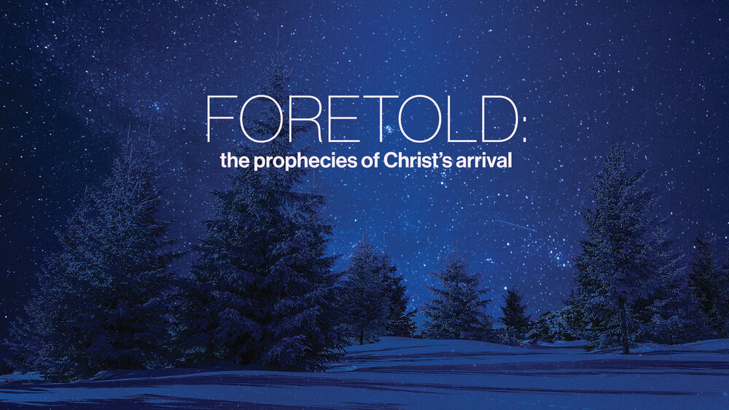

Slide 2
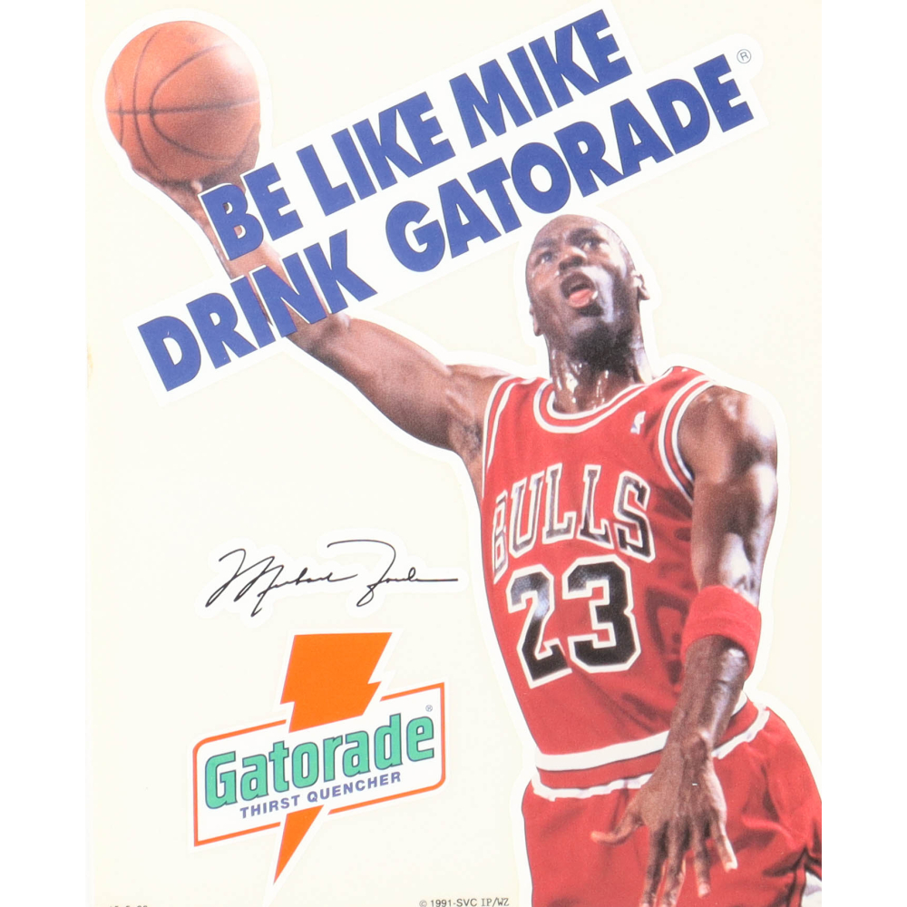

Slide 3


Slide 4
Big Idea
In the risen Jesus, our hostility has been replaced with intimacy, peace, acceptance, delight, & affection.

Slide 5
#1 – The Dispute
(3:8-9)
There is no hiding from God!

Slide 6
#2 – The Dread
(3:10)
God’s Goodness = Our greatest problem

Slide 7
#3 – The Declaration
(3:11)
It is the bad news that makes the good news the greatest news.

Slide 8
#4 – The Disguise
(3:12-13)
The lie embedded in every sin we choose: "God's holding out on me."

Slide 9
#5 – The Doom
(3:14-15)
Everyone in the world is either cursed or blessed.

Slide 10
#5 – The Doom
(3:14-15)
At the cross, Jesus purchased salvation, redeemed rebels, & crushed Satan. Glory to His name!

