Slide 1


Slide 2

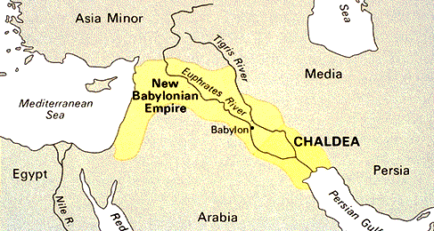
When was it written?
Only hint is 1:6 → coming invasion of Judah
Who are the Chaldeans?
  Diverse Aramean tribe in southern Babylon that began to take control as Assyria weakened.
How far out is the invasion? Not sure → 2:2-3
When did Babylon invade Judah? 605, 597, & 586 BC. So, Habakkuk was written before 605 BC.

Slide 3
Why does pre-605 BC matter?
What is going on in Judah in this time frame?
Succession of 4 kings: Manasseh, Amon, Josiah, Jehoahaz. (2 Kings 21-23; 2 Chronicles 33-36)
  2 Kings 21:1, 2, 9, 19-22, 26; 22:2, 11; 23:29-32
Given what Habakkuk sees before him (1:3-4), unlikely it was written during the peak of Josiah’s reign.
  So, most likely right after, when his son takes over and all the good Josiah did is coming undone.

Slide 4
Organization & Theme
1:1-11. “Question” (complaint) 1 & answer.
1:12-2:20. “Question” (complaint) 2 & answer.
3:1-19. Concluding prayer.
Theme: Reassurance. God is always sovereign and always working things for His glory (even if we don’t immediately see or understand it)
  Look for Habakkuk’s transformation

Slide 5
We’re part of the same cycle
Ecclesiastes 1:9-10
Tragically, God’s people questioning His plan/timing is not new
  With varying degrees of self-pity, skepticism, etc.
Genesis 18:10-15
Numbers 14:2-3
Jeremiah 15:10-18
Matthew 16:21-22

Slide 6
Habakkuk 1:1-4
“God what’s going on? Things used to be good in our country but now when I look around all I see is violence, rejection of law, abuse of justice… God, do You not see what’s going on, or worse, if You see the problem, why aren’t You doing something?”
No cross references. Let’s just sit with this. Do we hear Habakkuk’s accusative complaint echo in the Church today?

Slide 7
We must realize the problem of that
God is always aware (Proverbs 15:3; Hebrews 4:13)
God is always working (Isaiah 46:9b-10; John 5:17)
  Do we really dare even consider the thought that God doesn’t meet the standards He calls us to?
It’s wrong to ever throw “questions” at God that are really accusations (Isaiah 40:13-14; Malachi 2:17)

Slide 8
1:5-11
Ecclesiastes 7:10 “Say not, ‘Why were the former days better than these?’ For it is not from wisdom that you ask this.”
Isaiah 43:18-19 “Remember not the former things, nor consider the things of old. Behold, I am doing a new thing; now it springs forth, do you not perceive it?”
Preview of next week: what about when we don’t like God’s answer or plan?

Slide 9
We must (& can!) change perspective
“I would lay my case before Him
and fill my mouth with arguments.”
Job 23:1-6
Job 29:1-2
Job 30:19-21
Job 31:35
Job 38 (e.g., 1-4)
Job 40:1-8
Job 42:3-5
”I have uttered what
I did not understand”

Slide 10
This Week Let’s All
Read: Esther 3 & 9; Psalm 37 & 49; Hosea 6
Pray: As led by the Holy Spirit & Scripture
Remember: Habakkuk 3:17-19
Reflect: Am I inclined to complain in a similar manner to the Lord? Do I too easily lose sight of His sovereignty?
Next Week’s Sermon: Habakkuk 1:12-2:20

