Slide 1
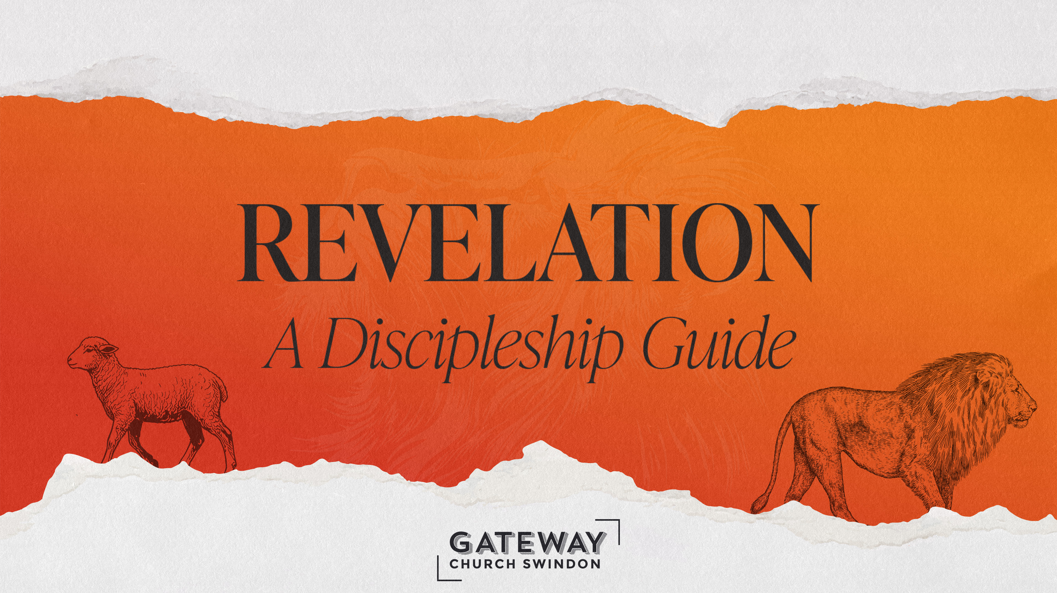

Slide 2
Notes:
Click the button to advance to the next slide and then leave the pc alone if preacher is controlling!

Slide 3
5 Then I saw in the right hand of him who sat on the throne a scroll with writing on both sides and sealed with seven seals. ² And I saw a mighty angel proclaiming in a loud voice, ‘Who is worthy to break the seals and open the scroll?’ ³ But no one in heaven or on earth or under the earth could open the scroll or even look inside it.
- Revelation 5:1-14 (NIVUK)
Notes:
Text Gil Sans MT 40
Ref Gil Sans MT 24

Slide 4
⁴ I wept and wept because no one was found who was worthy to open the scroll or look inside. ⁵ Then one of the elders said to me, ‘Do not weep! See, the Lion of the tribe of Judah, the Root of David, has triumphed. He is able to open the scroll and its seven seals.’
- Revelation 5:1-14 (NIVUK)
Notes:
Text Gil Sans MT 40
Ref Gil Sans MT 24

Slide 5
⁶ Then I saw a Lamb, looking as if it had been slain, standing at the centre of the throne, encircled by the four living creatures and the elders. The Lamb had seven horns and seven eyes, which are the seven spirits of God sent out into all the earth. ⁷ He went and took the scroll from the right hand of him who sat on the throne.
- Revelation 5:1-14 (NIVUK)
Notes:
Text Gil Sans MT 40
Ref Gil Sans MT 24

Slide 6
⁸ And when he had taken it, the four living creatures and the twenty-four elders fell down before the Lamb. Each one had a harp and they were holding golden bowls full of incense, which are the prayers of God’s people. ⁹ And they sang a new song, saying:
- Revelation 5:1-14 (NIVUK)
Notes:
Text Gil Sans MT 40
Ref Gil Sans MT 24

Slide 7
‘You are worthy to take the scroll
and to open its seals,
because you were slain,
and with your blood you purchased for God
persons from every tribe and language and people and nation.
¹⁰ You have made them to be a kingdom and priests to serve our God,
and they will reign on the earth.’
- Revelation 5:1-14 (NIVUK)
Notes:
Text Gil Sans MT 40
Ref Gil Sans MT 24

Slide 8
¹¹ Then I looked and heard the voice of many angels, numbering thousands upon thousands, and ten thousand times ten thousand. They encircled the throne and the living creatures and the elders.
- Revelation 5:1-14 (NIVUK)
Notes:
Text Gil Sans MT 40
Ref Gil Sans MT 24

Slide 9
¹² In a loud voice they were saying:
‘Worthy is the Lamb, who was slain,
to receive power and wealth and wisdom and strength
and honour and glory and praise!’
- Revelation 5:1-14 (NIVUK)
Notes:
Text Gil Sans MT 40
Ref Gil Sans MT 24

Slide 10
¹³ Then I heard every creature in heaven and on earth and under the earth and on the sea, and all that is in them, saying:
‘To him who sits on the throne and to the Lamb
be praise and honour and glory and power,
for ever and ever!’
¹⁴ The four living creatures said, ‘Amen’, and the elders fell down and worshipped.
- Revelation 5:1-14 (NIVUK)
Notes:
Text Gil Sans MT 40
Ref Gil Sans MT 24

Slide 11
Notes:
Click the button to advance to the next slide and then leave the pc alone if preacher is controlling!

Slide 12
⁹ You are a lion’s cub, Judah;
you return from the prey, my son.
Like a lion he crouches and lies down,
like a lioness – who dares to rouse him?
¹⁰ The sceptre will not depart from Judah,
nor the ruler’s staff from between his feet
- Genesis 49:9-10a (NIVUK)
Notes:
Text Gil Sans MT 40
Ref Gil Sans MT 24

Slide 13
“Aslan is a lion – the Lion, the great Lion." "Ooh" said Susan. "I'd thought he was a man. Is he quite safe? I shall feel rather nervous about meeting a lion" . . . "Safe?" said Mr Beaver . . . "Who said anything about safe? 'Course he isn't safe. But he's good. He's the King, I tell you.”
- The Lion, the Witch & the Wardrobe – C.S. Lewis
Notes:
Text Gil Sans MT 40
Ref Gil Sans MT 24

Slide 14
⁷ He was oppressed and afflicted,
yet he did not open his mouth;
he was led like a lamb to the slaughter,
and as a sheep before its shearers is silent,
so he did not open his mouth.
- Isaiah 53:7 (NIVUK)
Notes:
Text Gil Sans MT 40
Ref Gil Sans MT 24

Slide 15
⁶ We all, like sheep, have gone astray,
each of us has turned to our own way;
and the Lord has laid on him
the iniquity of us all.
- Isaiah 53:6 (NIVUK)
Notes:
Text Gil Sans MT 40
Ref Gil Sans MT 24

Slide 16
¹¹ I saw heaven standing open and there before me was a white horse, whose rider is called Faithful and True. With justice he judges and wages war. ¹² His eyes are like blazing fire, and on his head are many crowns. He has a name written on him that no one knows but he himself. ¹³ He is dressed in a robe dipped in blood, and his name is the Word of God.
- Revelation 19:11-16 (NIVUK)
Notes:
Text Gil Sans MT 40
Ref Gil Sans MT 24

Slide 17
¹⁴ The armies of heaven were following him, riding on white horses and dressed in fine linen, white and clean. ¹⁵ Coming out of his mouth is a sharp sword with which to strike down the nations. ‘He will rule them with an iron sceptre.’ He treads the winepress of the fury of the wrath of God Almighty.
- Revelation 19:11-16 (NIVUK)
Notes:
Text Gil Sans MT 40
Ref Gil Sans MT 24

Slide 18
¹⁶ On his robe and on his thigh he has this name written:
king of kings and lord of lords.
- Revelation 19:11-16 (NIVUK)
Notes:
Text Gil Sans MT 40
Ref Gil Sans MT 24

Slide 19
⁵ You prepare a table before me
in the presence of my enemies.
You anoint my head with oil;
my cup overflows.
⁶ Surely your goodness and love will follow me
all the days of my life,
and I will dwell in the house of the Lord
for ever.
- Psalm 23:5-6 (NIVUK)
Notes:
Text Gil Sans MT 40
Ref Gil Sans MT 24

Slide 20
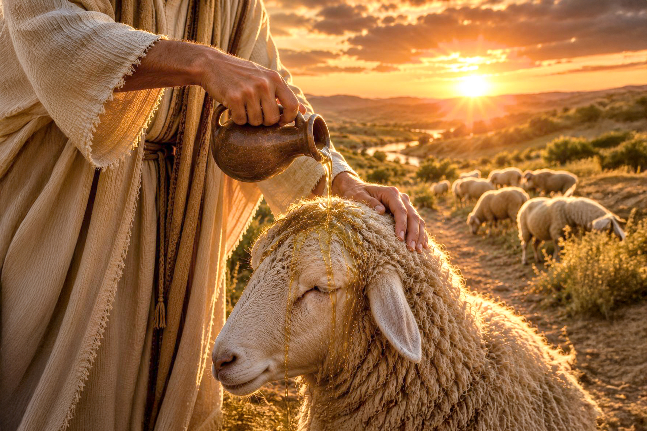

Slide 21
⁵ In your relationships with one another, have the same mindset as Christ Jesus:
⁶ who, being in very nature God,
did not consider equality with God something to be used to his own advantage;
⁷ rather, he made himself nothing
by taking the very nature of a servant,
being made in human likeness.
- Philippians 2: 5-7 (NIVUK)
Notes:
Text Gil Sans MT 40
Ref Gil Sans MT 24

Slide 22
¹⁰ Finally, be strong in the Lord and in his mighty power. ¹¹ Put on the full armour of God, so that you can take your stand against the devil’s schemes.
- Ephesians 6:10-11 (NIVUK)
Notes:
Text Gil Sans MT 40
Ref Gil Sans MT 24

Slide 23
¹⁷ Take the helmet of salvation and the sword of the Spirit, which is the word of God.
- Ephesians 6:17 (NIVUK)
Notes:
Text Gil Sans MT 40
Ref Gil Sans MT 24

Slide 24
¹⁸ And pray in the Spirit on all occasions with all kinds of prayers and requests. With this in mind, be alert and always keep on praying for all the Lord’s people.
- Ephesians 6:18 (NIVUK)
Notes:
Text Gil Sans MT 40
Ref Gil Sans MT 24

Slide 25
Notes:
Click the button to advance to the next slide and then leave the pc alone if preacher is controlling!

